Slide 1
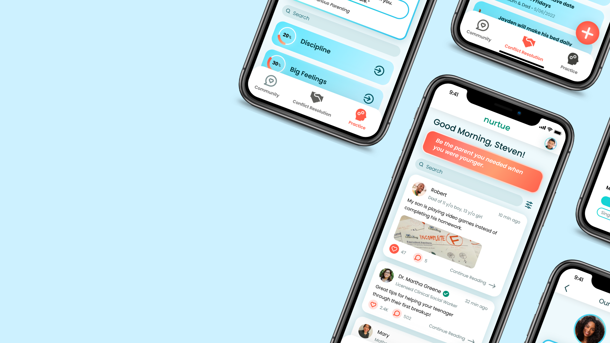


Team 2, “Caring From Within” - 2:30PM

Slide 2
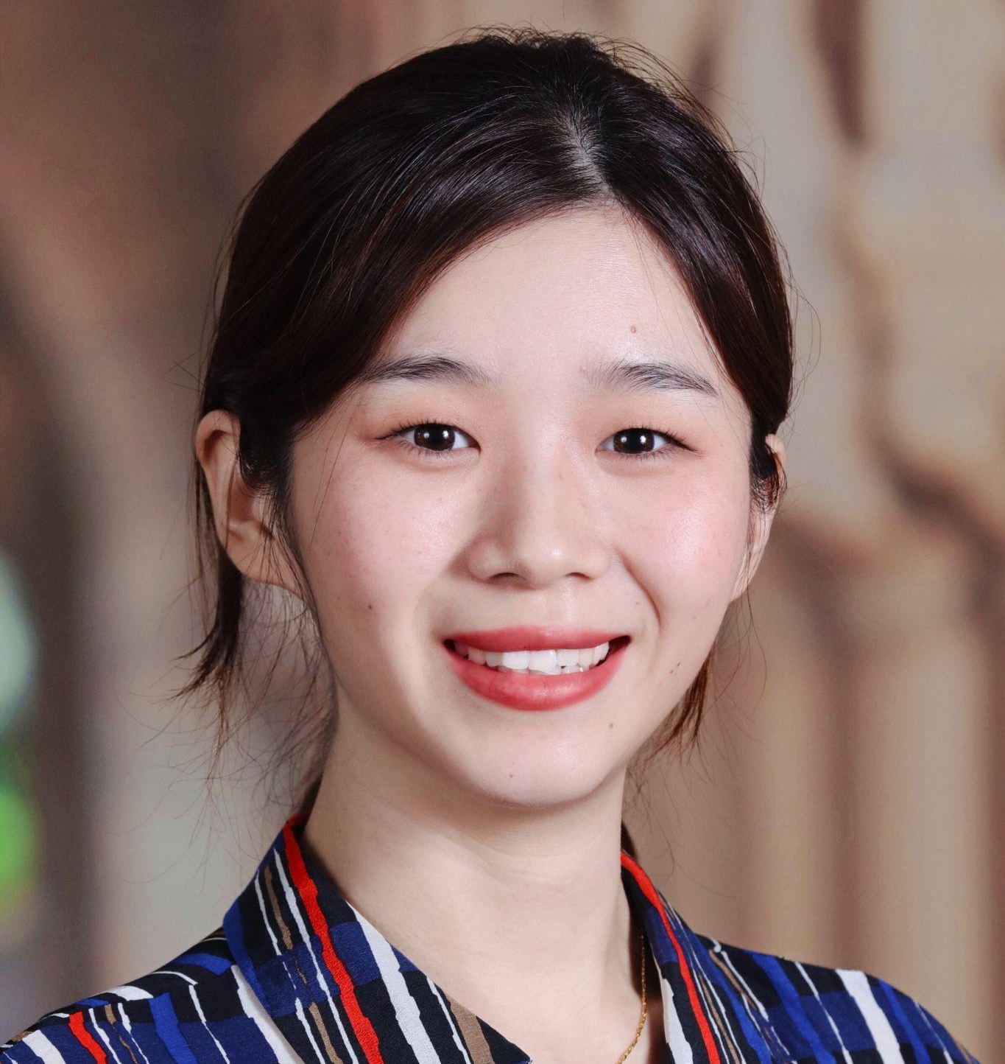
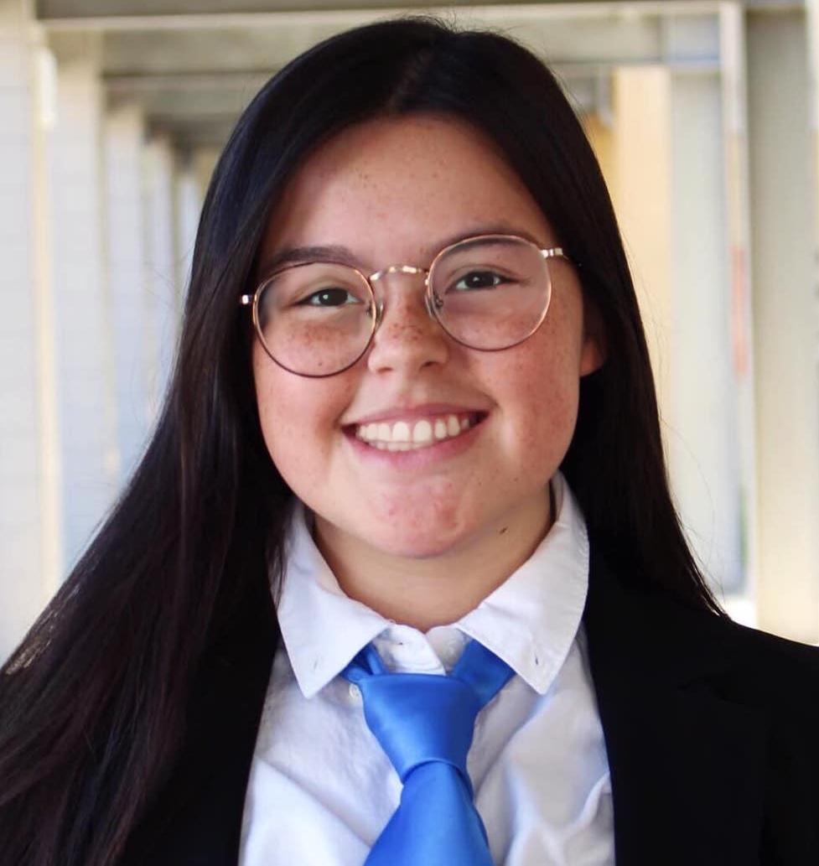
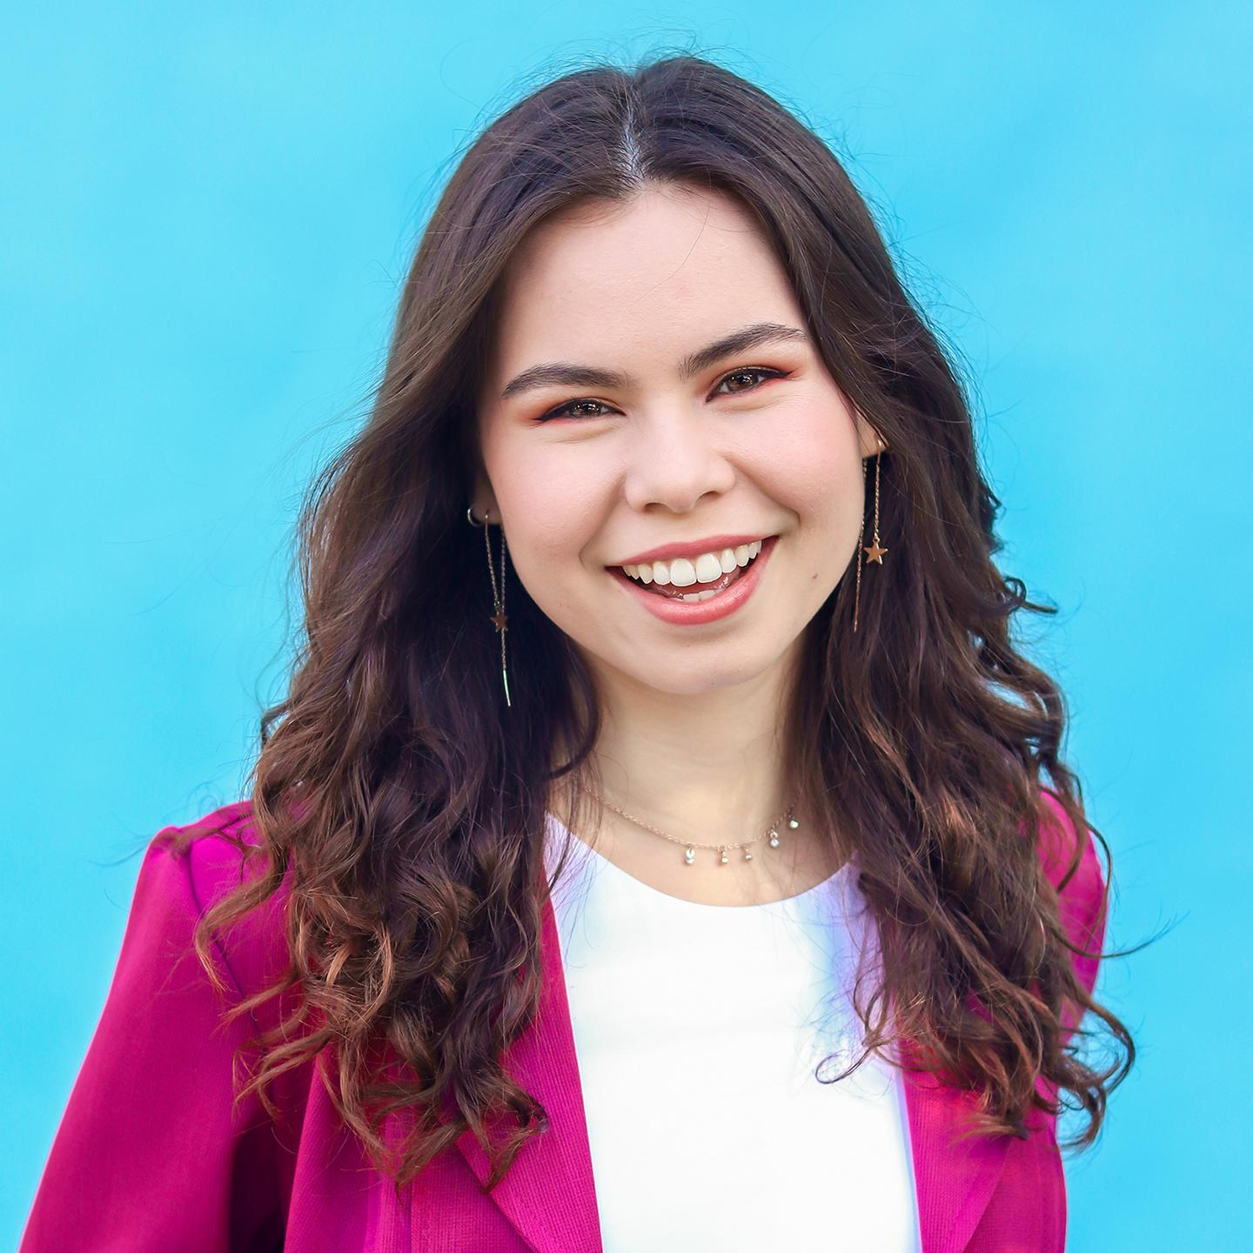
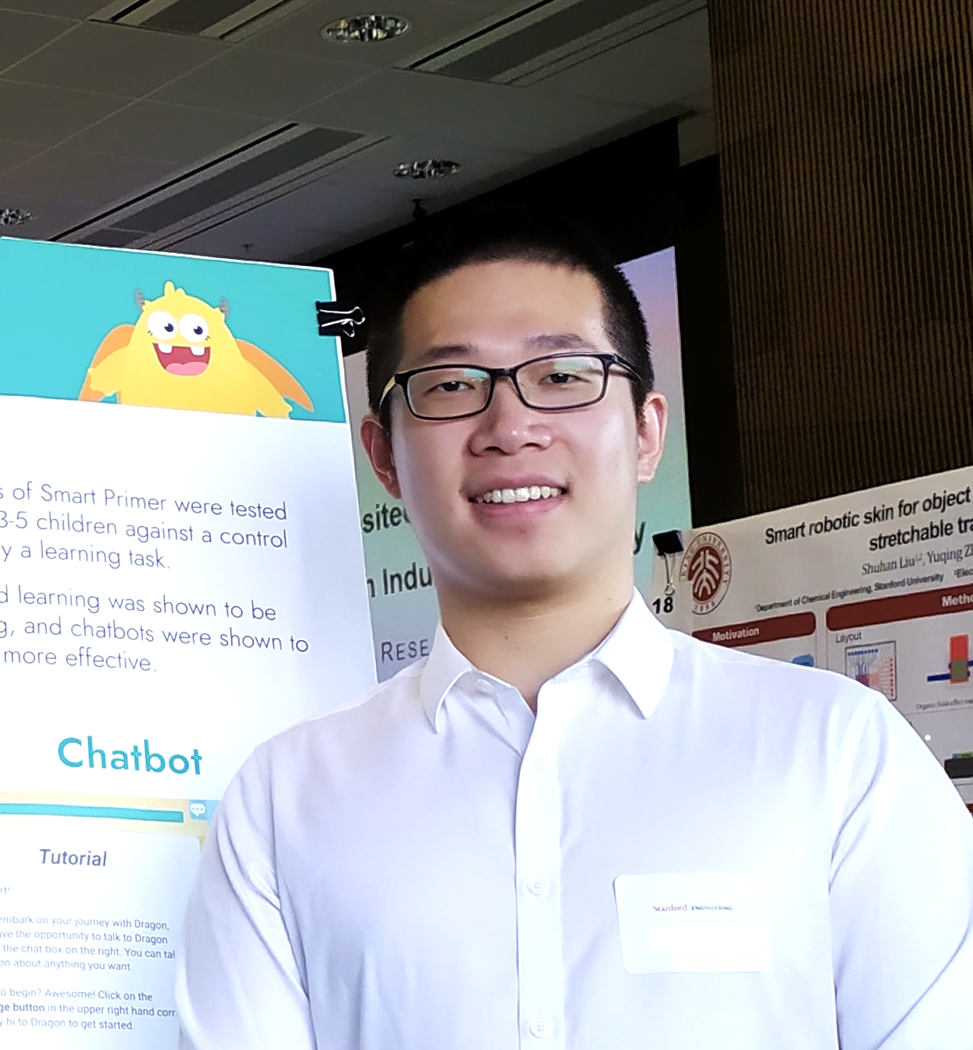
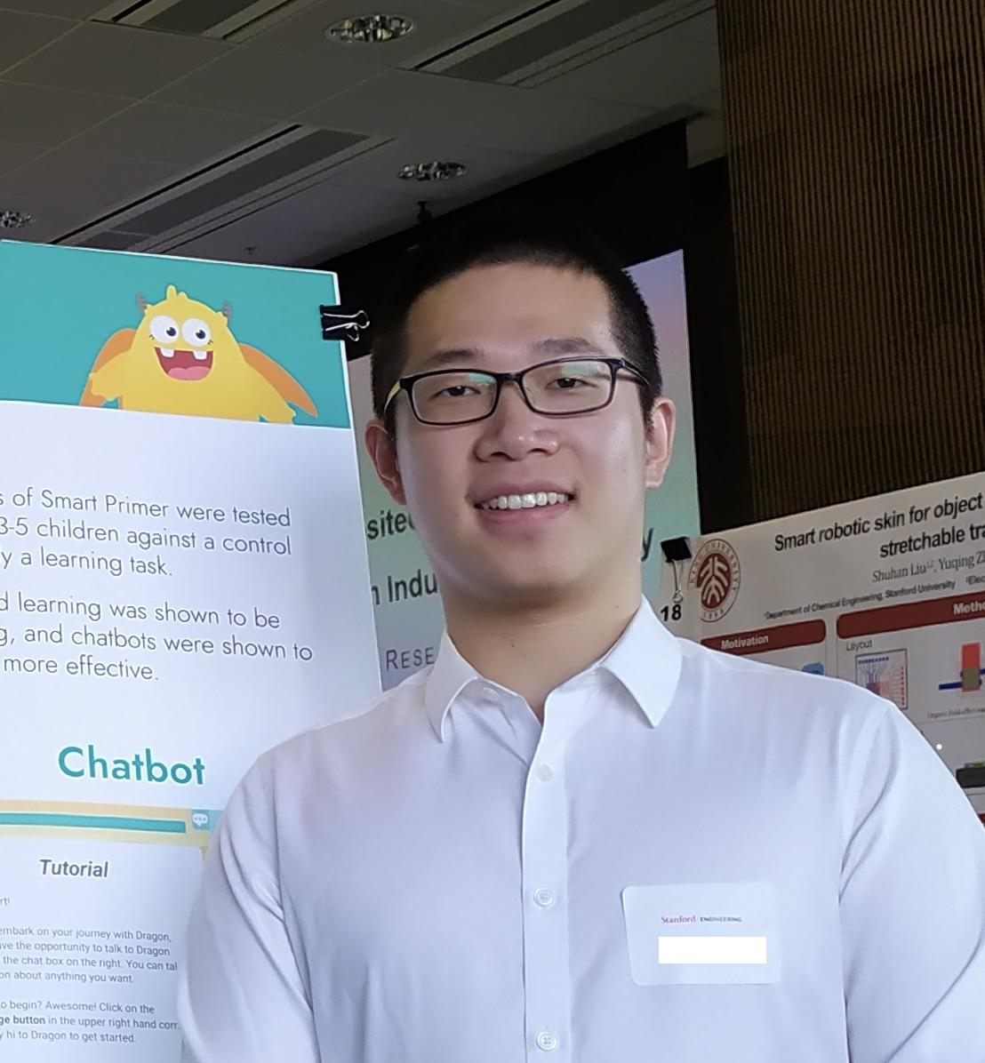
Our Team
Meng G.
UX Researcher
M.S. Symbolic Systems, C/O ‘23
Catherine H.
Product Manager
B.S. Computer Science (HCI),
C/O ‘23
Dyllen N.
Product Designer
B.S. Human-Centered Design and Engineering,
C/O ‘24
Rui Y.
Software Engineer
M.S. Computer Science (HCI), C/O ‘23

Slide 3
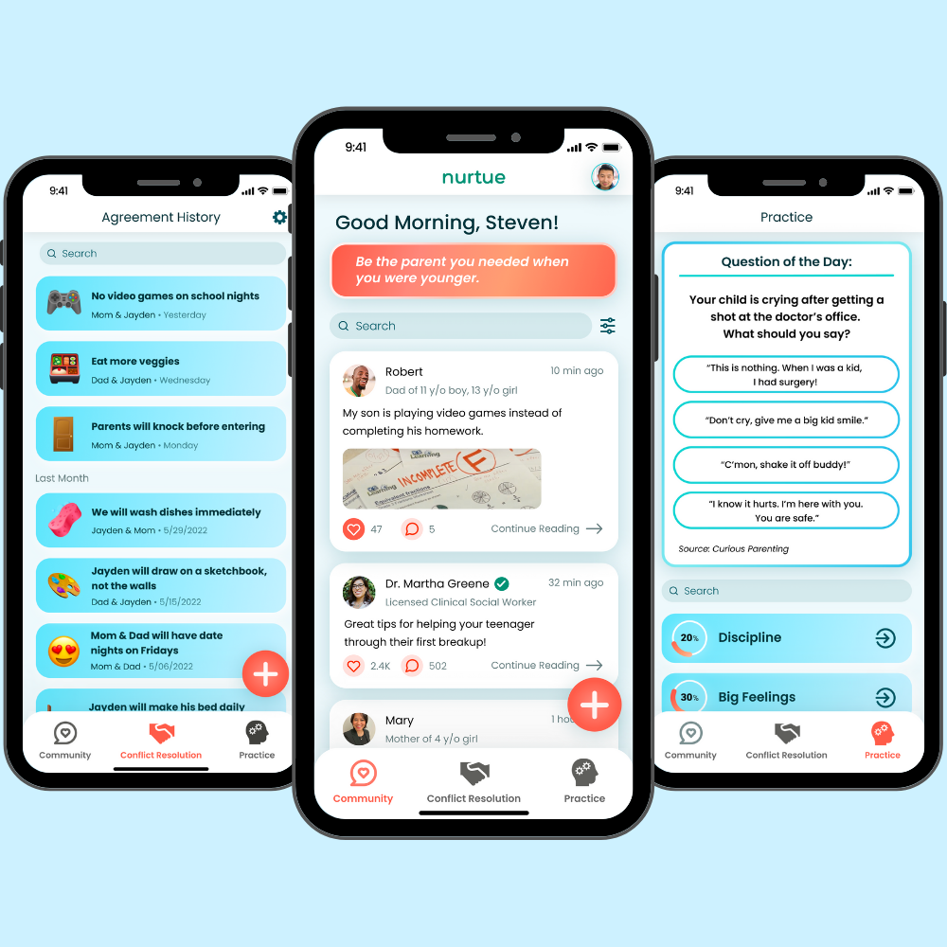
Value Proposition
The Problem
The Solution
Grow together.
Parents often feel inadequate in their parenting efforts and would like validation and guidance. They also express concerns about handling conflicts with their children, and want more effective conflict resolution.
Nurtue exists to improve relationships between parents and their children by promoting healthy communication habits and communal support. Nurtue connects parents with experts for recommendations, uses quizzes to help parents practice parenting skills and makes conflict resolution between parents and kids more meaningful.

Slide 4
Overview
Heuristic Evaluation Results
Revised Design
Hi-Fi Prototype Status
Hi-Fi Prototype Demo

Slide 5
Additional
Needfinding
Heuristic Evaluation

Slide 6
Summary of Results
Severity 3-4:
19 Heuristic Violations → 13 Changes
Severity 1-2:
49 Heuristic Violations → 23 Changes

Slide 7
Most Violated Heuristics
H4: Consistency & Standards
22
H7: Efficiency of Use
10
H2: Match System & World
7

Slide 8
Additional
Needfinding
Revised Design

Slide 9
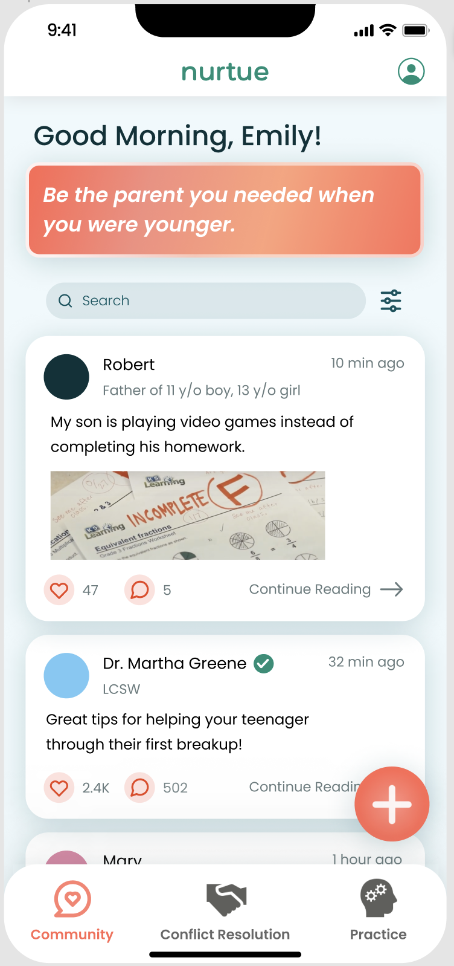
ISSUES: COMMUNITY PAGE
Some box items have more rounded corners than others. (H4)
The search bar is not aligned with the rest of the items on the page. (H4)
Users are unsure whether a “like” button is already pushed or not. (H4)
Dr. Martha Green’s occupation of “LCSW” may be unfamiliar to some parents. (H12)

Slide 10
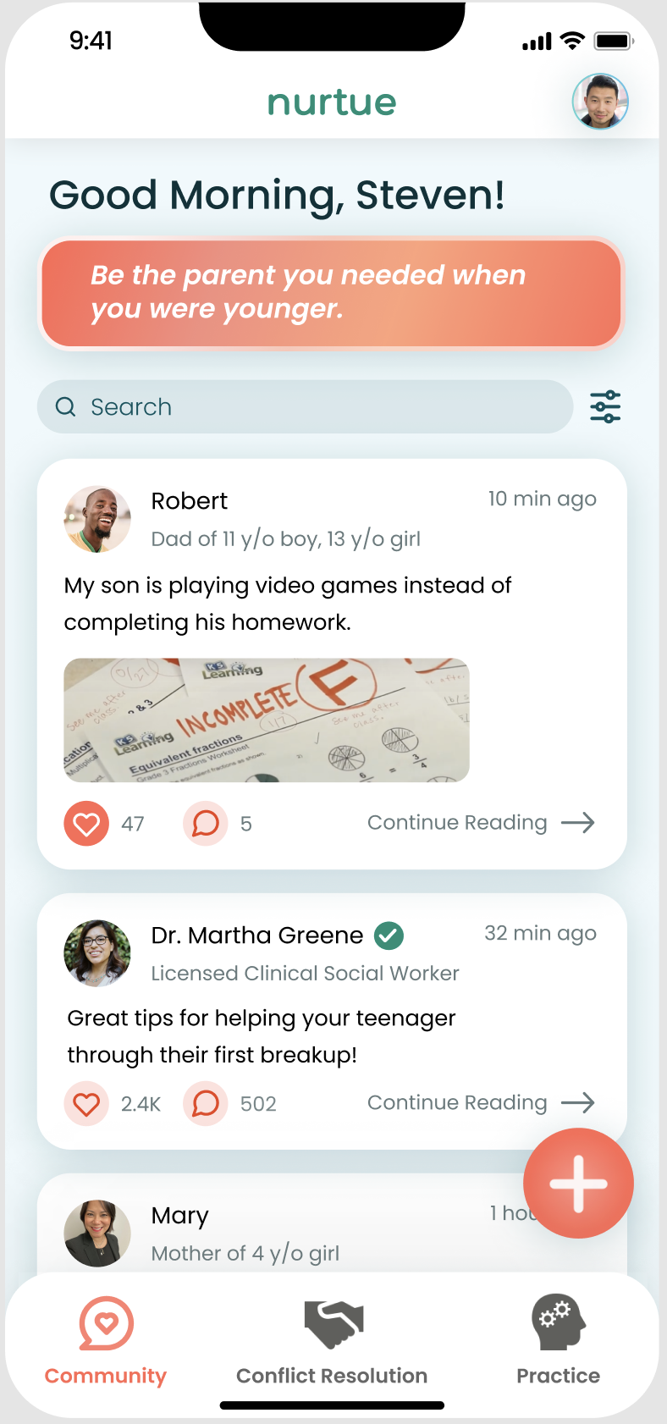
FIXES:
Increase the border radius of the daily affirmation to match the other boxes.
Align the search bar with the other elements.
Demonstrate what a “liked” post looks like by changing the colors of the button.
Change “LCSW” to “Licenced Clinical Social Worker”

Slide 11
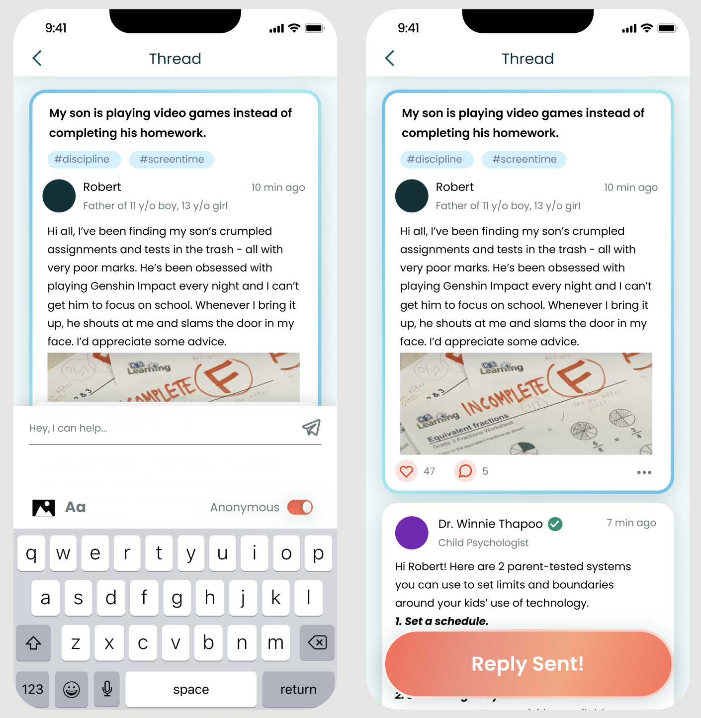
ISSUES: REPLYING TO A POST
When responding to a community post thread, a “Reply Sent!” confirmation that pops up, but the user cannot actually see their response in the thread. (H1)
Users need a way to report or delete posts and comments. (H12)
The paper airplane icon is difficult to tap and notice due to color and sizing. (H5) (H11)

Slide 12
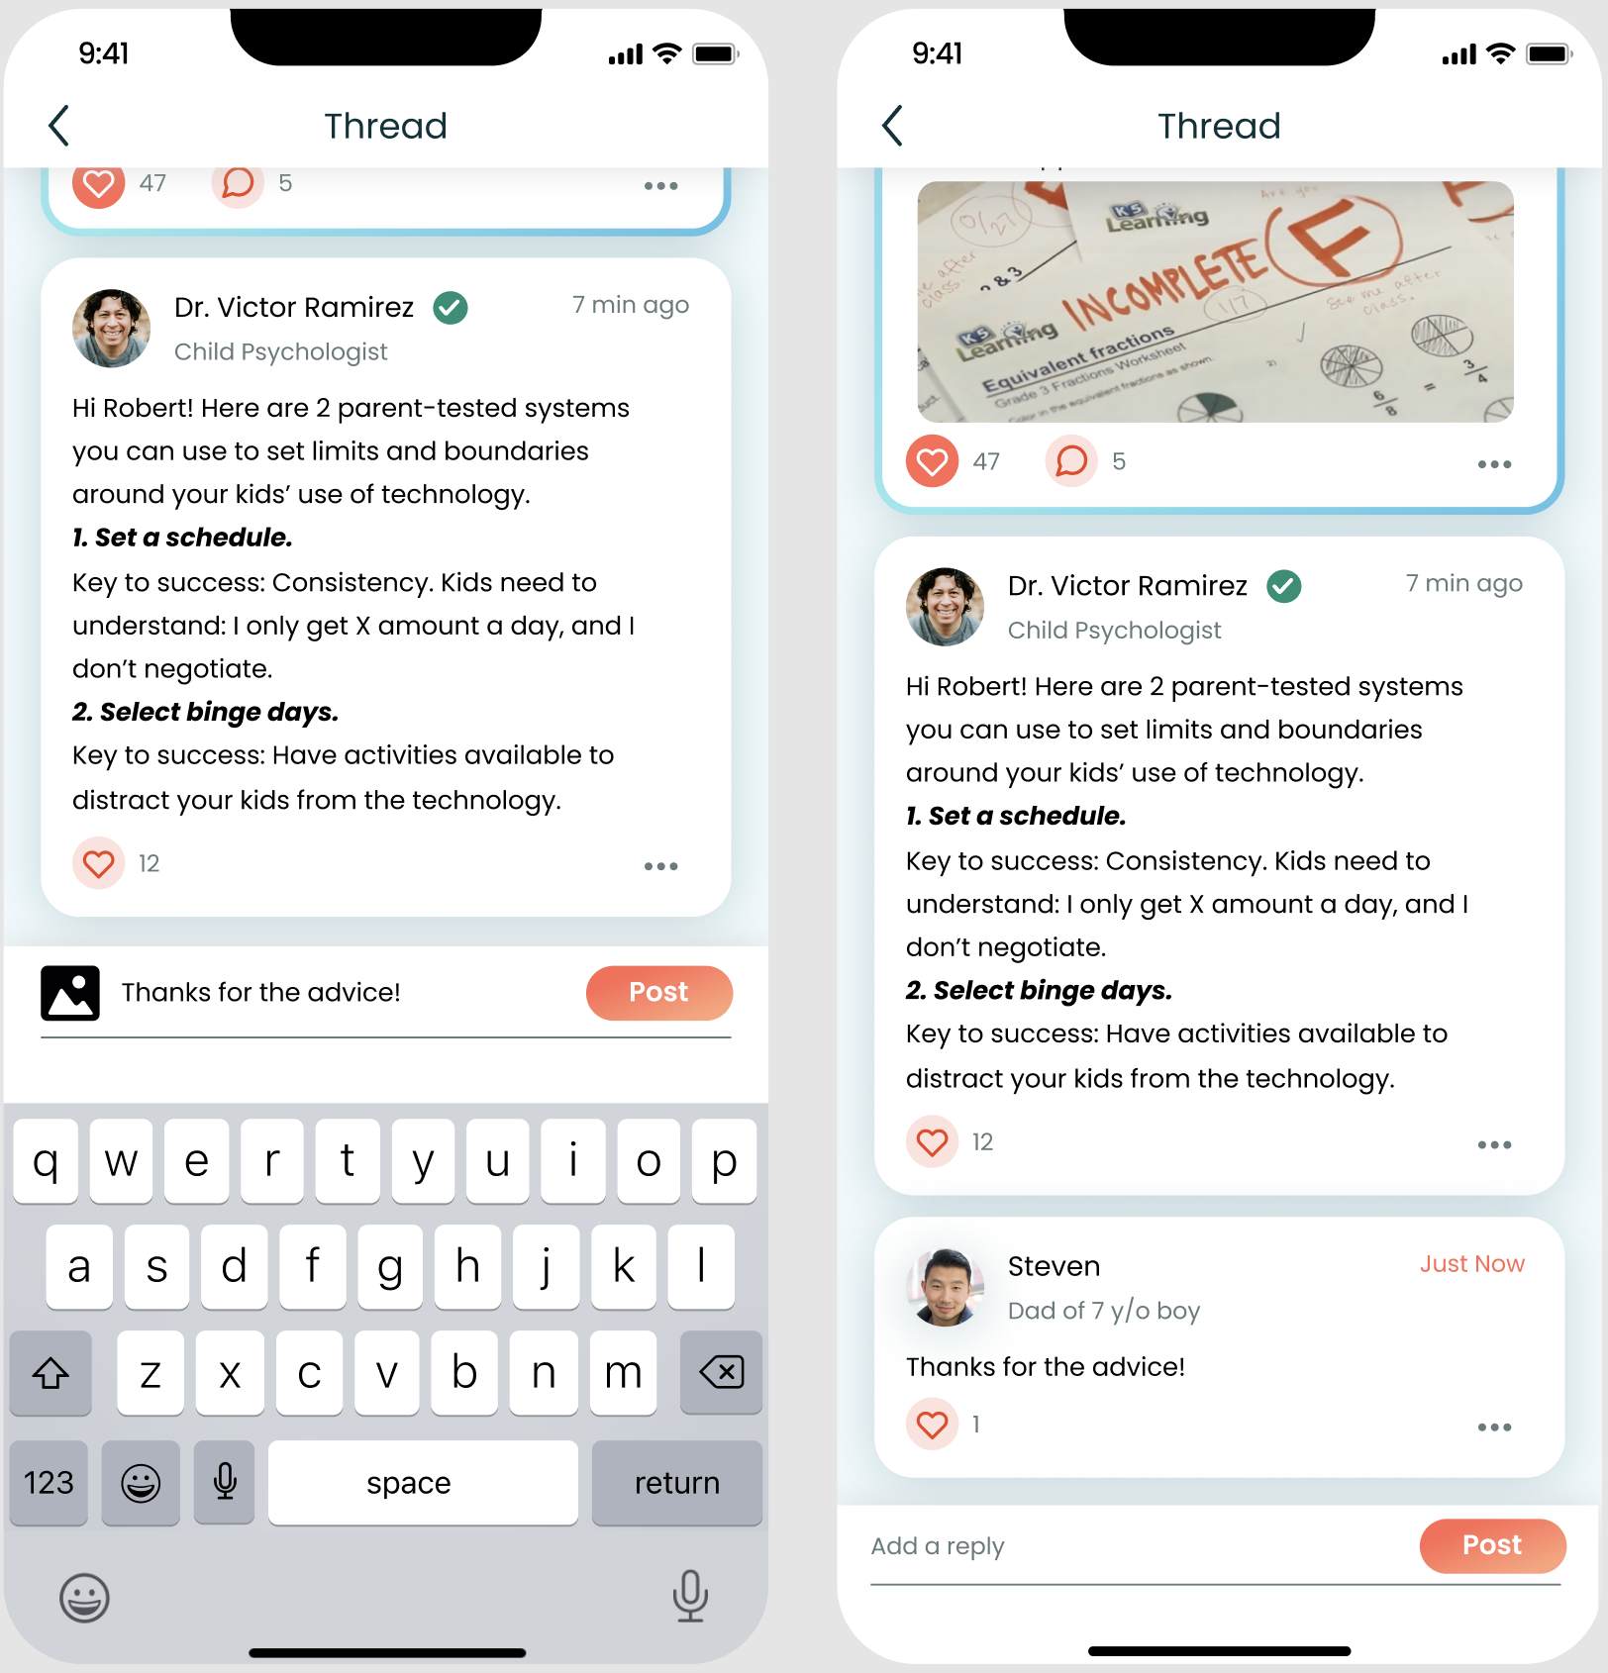
FIXES:
Hi-Fi prototype now supports deleting & reporting a post.
Swap out the paper airplane icon for a post button that is easy to see and consistent with the design system.
When a user hits the reply button, they can see their reply at the bottom of the thread.

Slide 13
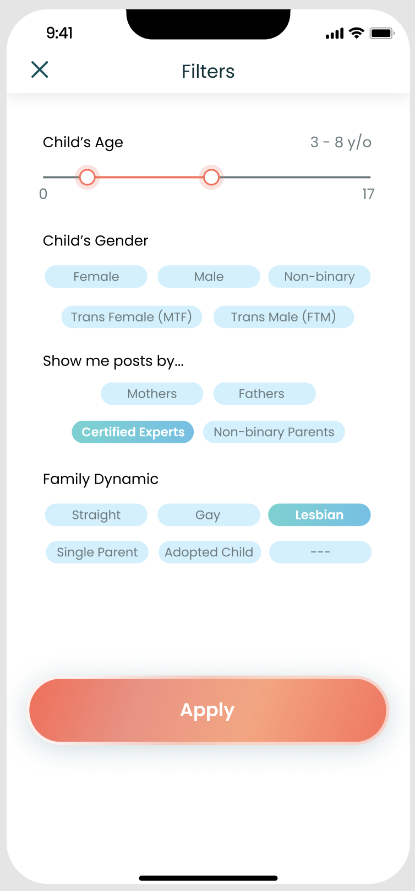
ISSUES: FILTERS PAGE
No indication of how many results will be returned when the filters are applied. (H1)
The differentiation between a selected and unselected button is difficult to see. (H11)
Gender category does not account for people who identify outside of the given options. (H12)
Child’s age selection bar is unintuitive for some users. (H11)

Slide 14
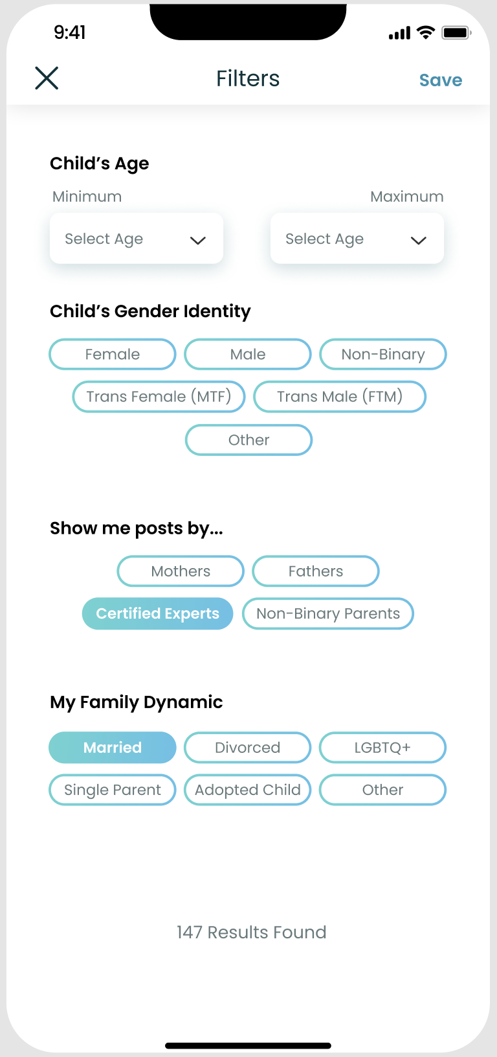
FIXES:
A more intuitive way for users to select the min and max ages.
Change the unselected button style to white with a blue border.
Gender identity includes “other”.
Changes to family dynamic categories.
Number of results found is shown at the bottom.

Slide 15
ISSUES: USER PROFILE
The filters page allows users to filter through posts by child’s age, gender, and family dynamic, but there is no explicit field to input this information. (H4)
If the app is on one parent’s phone, it is difficult for another parent to view their shared agreements. (H7)

Slide 16
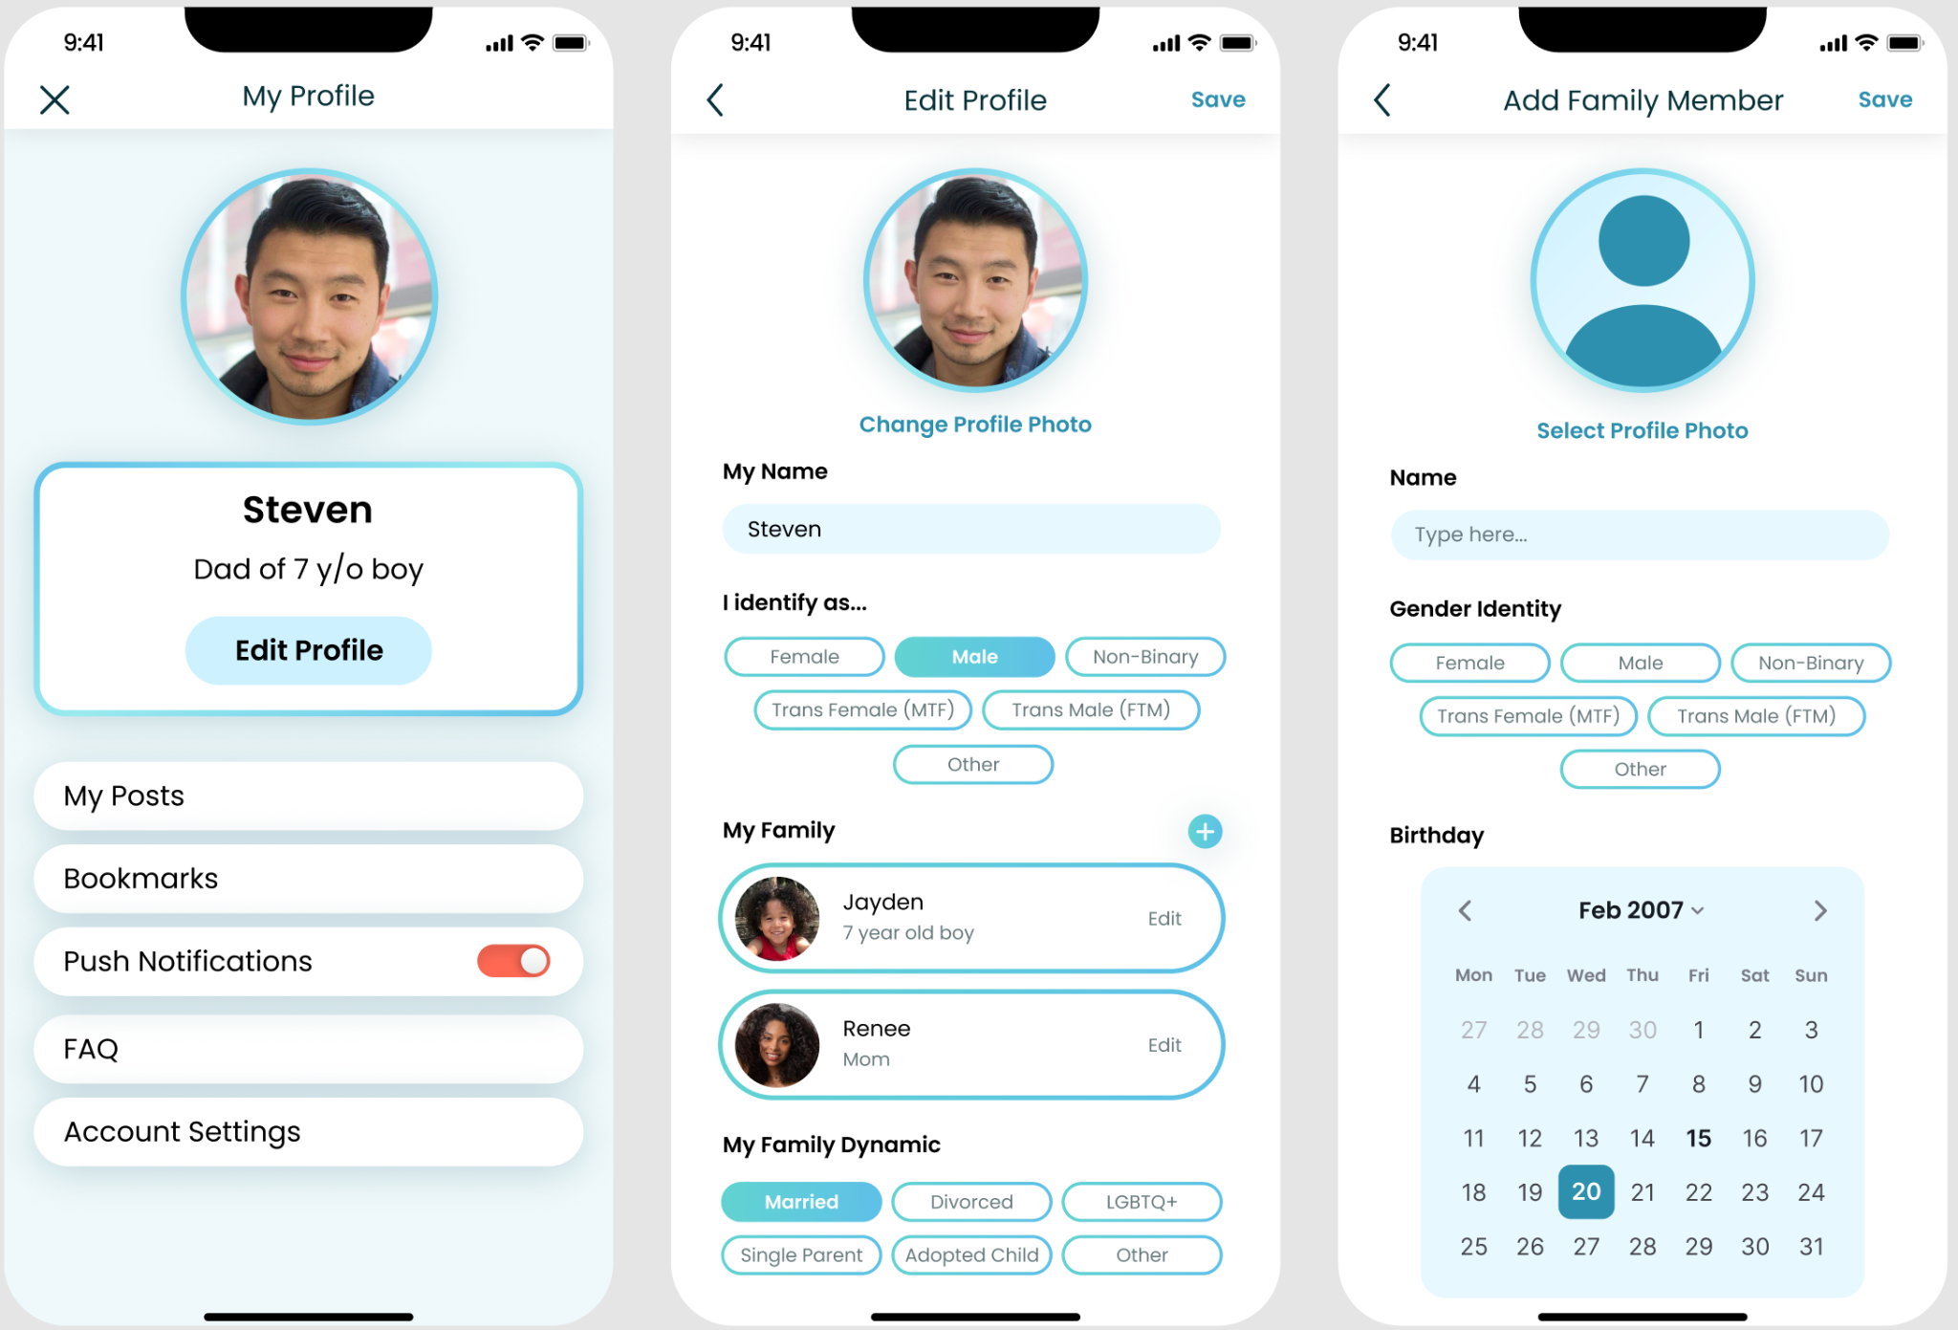
FIXES:
Design a profile page that allows users to specify their identity, family, and other information.

Slide 17
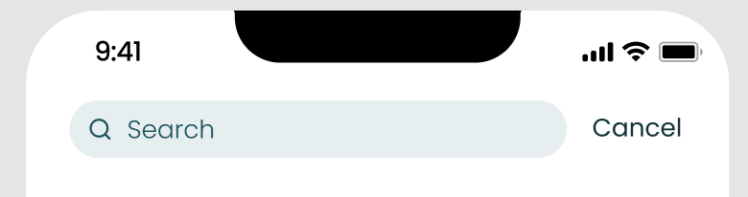
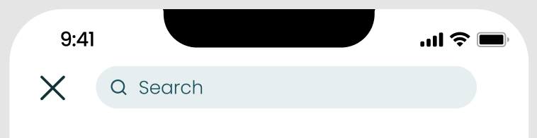
ISSUE: SEARCH PAGE
There is a “Cancel” button that is inconsistent with other cases in the app when the user wants to exit using “<” or “x”. (H4)
Before
FIX:
Remove the “Cancel” button and insert an “x” in the left hand corner, similar to the other screens.
After

Slide 18
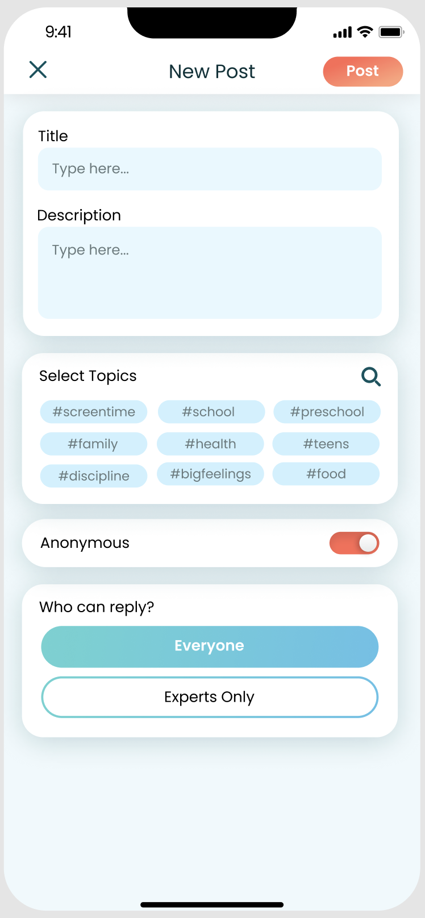
ISSUES: NEW POST
One of the posts in the Community page displays an image, but when making a post there is no option to add a picture. (H4)
If the user clicks the “x” there is no confirmation message, so if they accidentally clicked it, all their work would be lost. (H5)

Slide 19
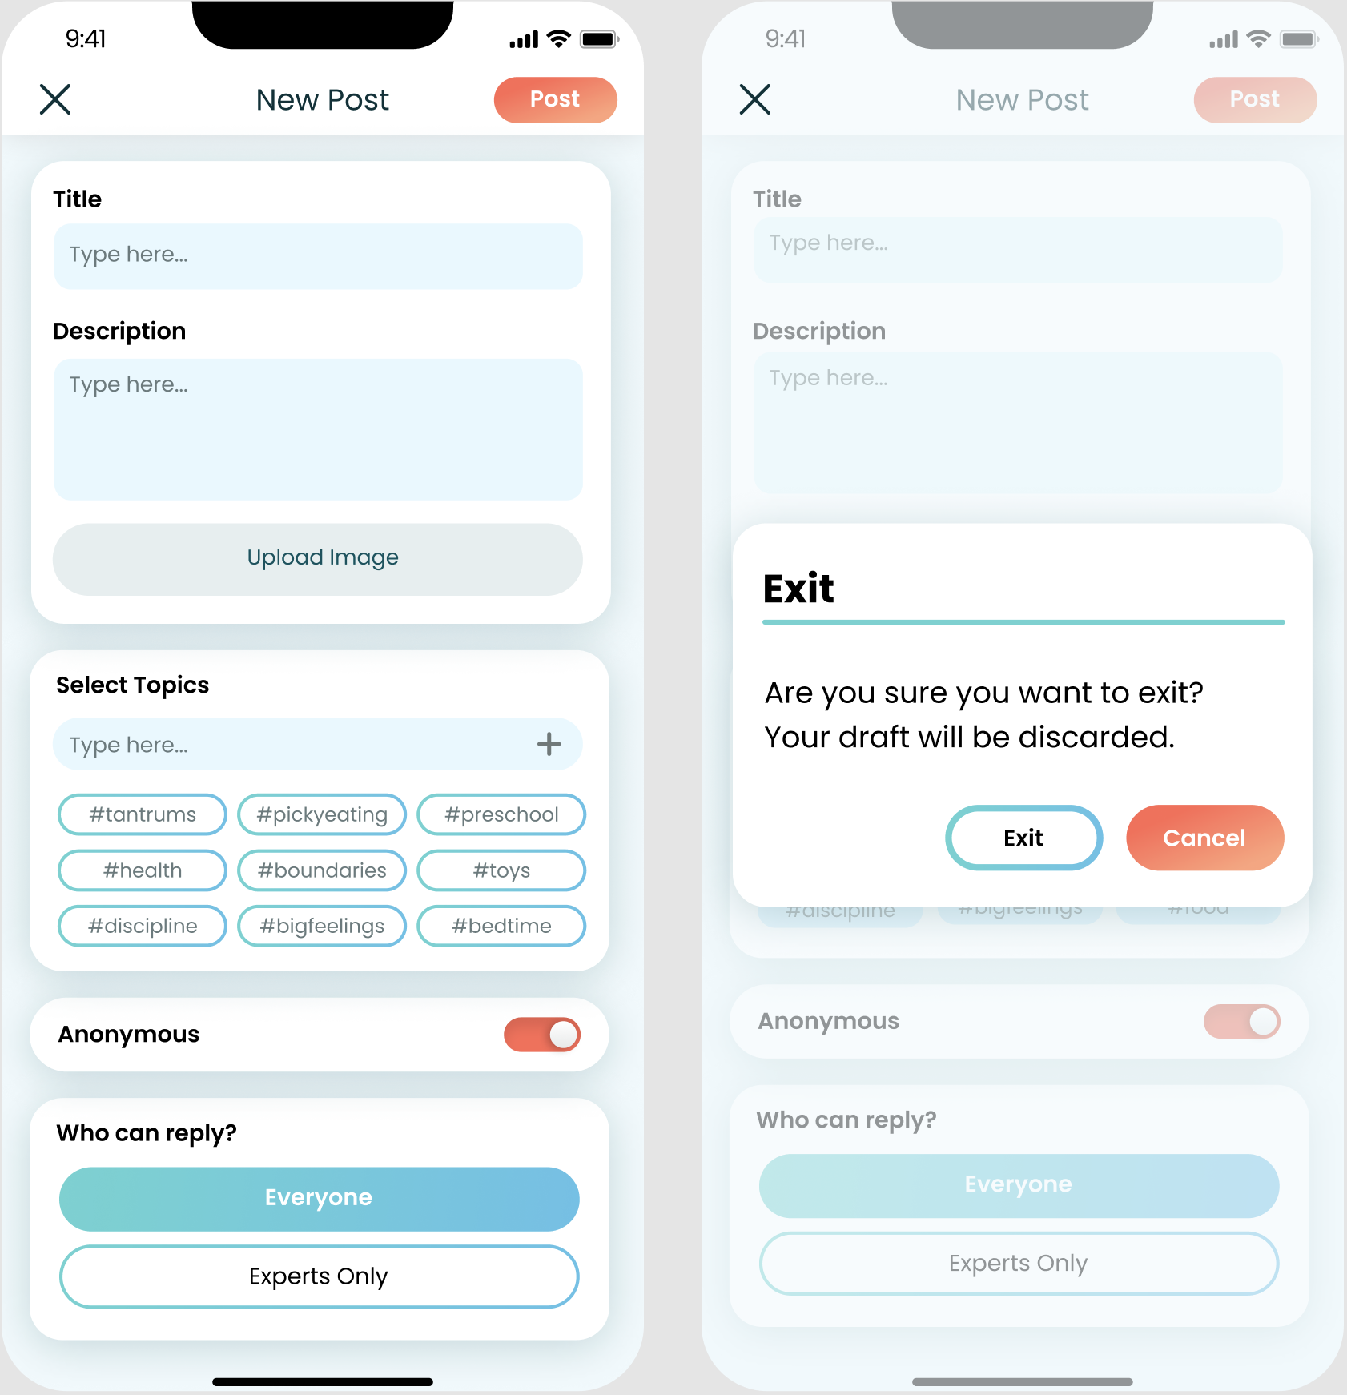
FIXES:
Add an option to upload an image
When users tap the “x”, a confirmation pops up

Slide 20
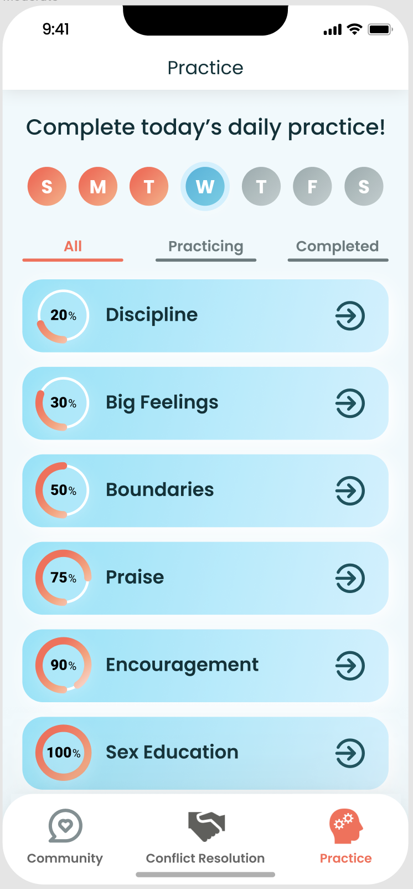
ISSUES: PRACTICE PAGE
Tracker at the top is lacking in functionality. It does not indicate time periods longer than a week or keep track of streaks. (H1)
No indication of what today’s daily practice means. Users are just shown a list of modules. (H2)
No way for users to search through the modules by name. (H7)

Slide 21
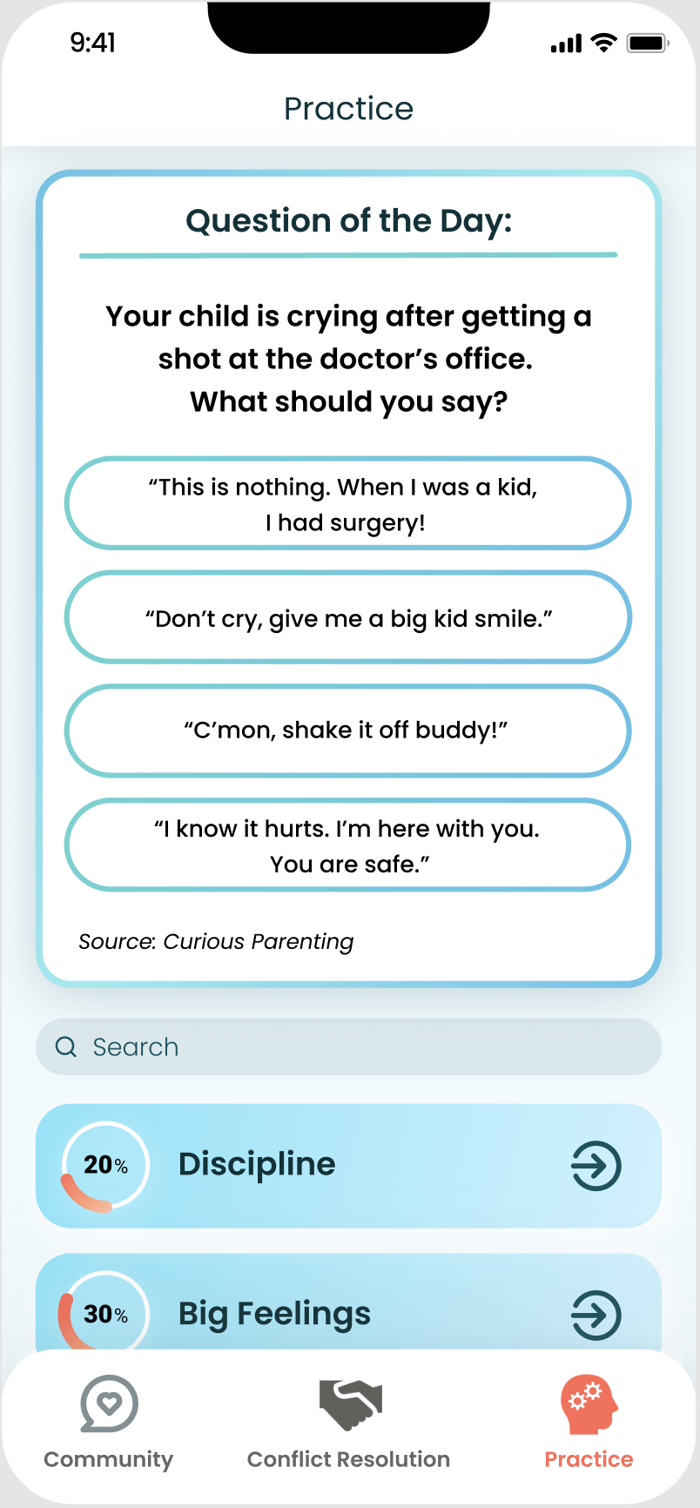
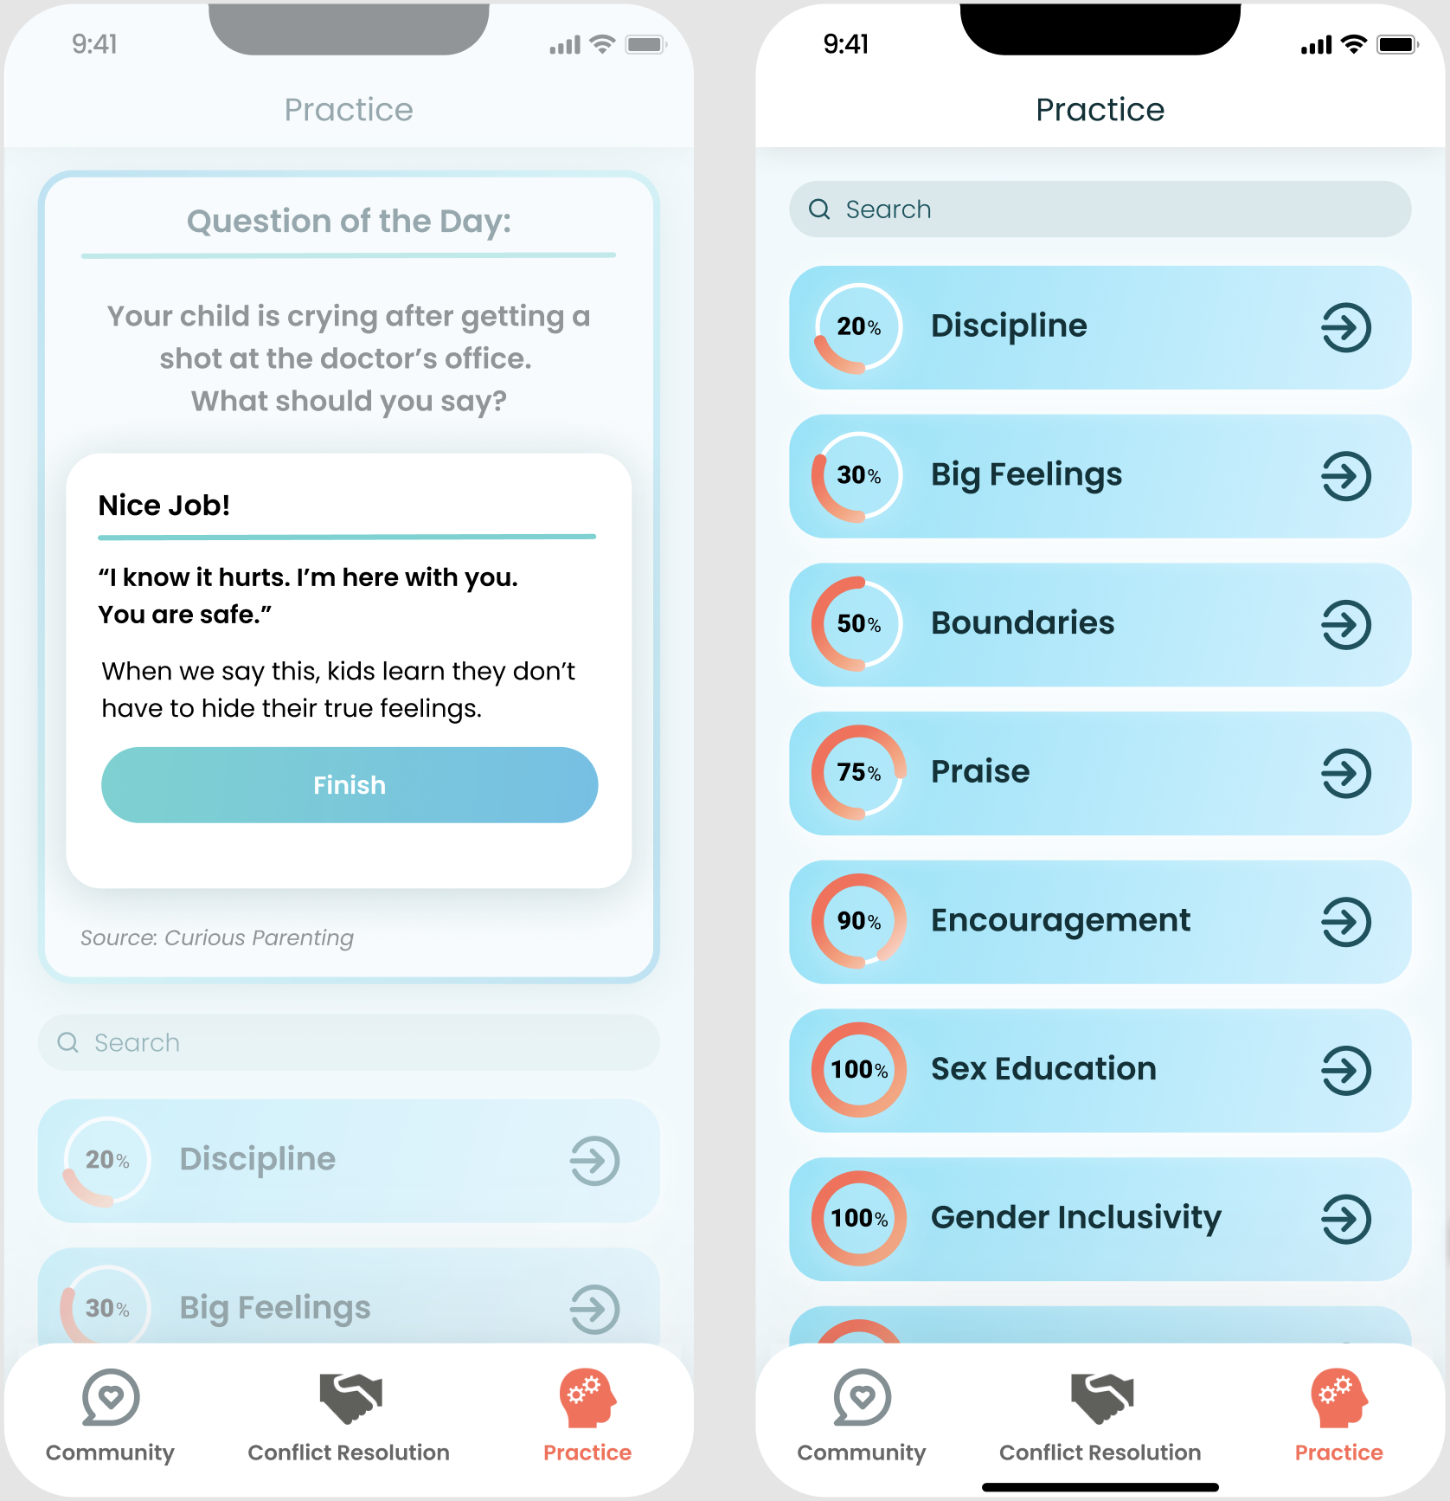
FIXES:
Remove the daily log and instead add a “Question of the Day”.
Add a search bar for users to find specific modules.

Slide 22
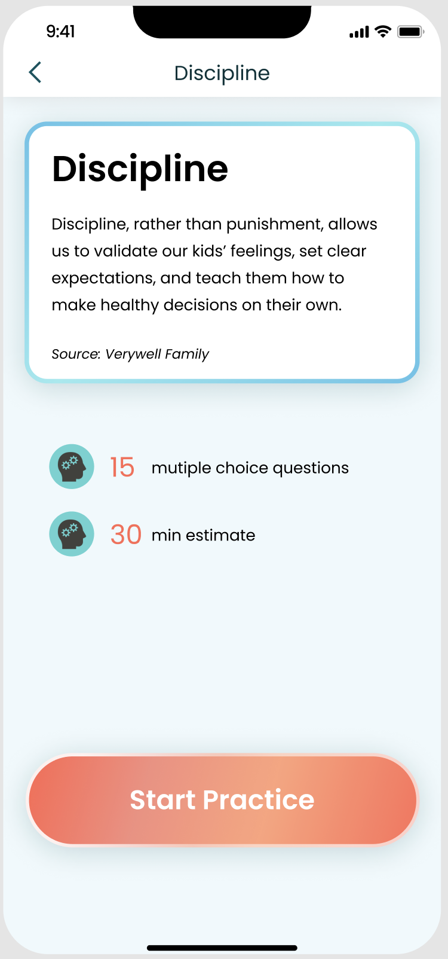
ISSUES: PRACTICE PAGE
The “Practice” page shows that the user has already started the “Discipline” module, but the button the discipline page indicates they have yet to start. (H4)
Users may want to review previously answered questions. (H3)

Slide 23
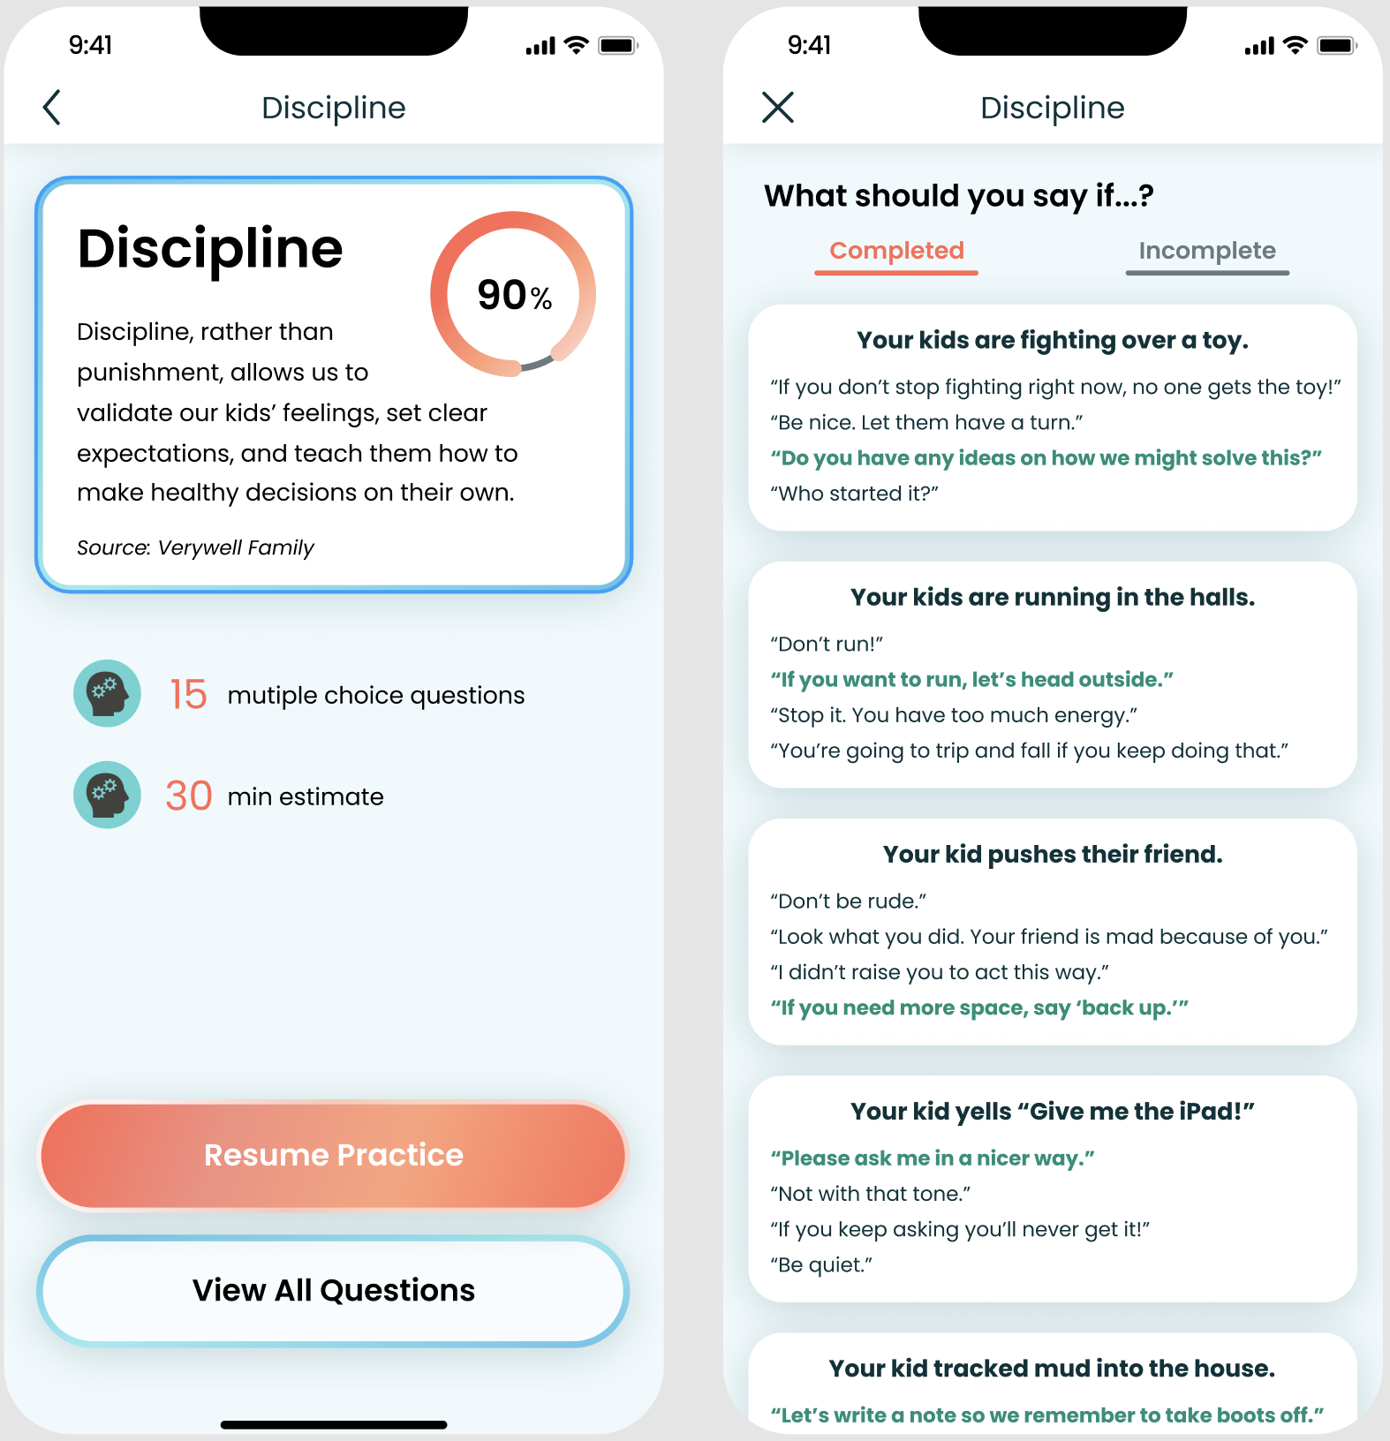
FIXES:
Include a page with all of the questions and answers in the module.
Say “Resume Practice” for modules that have already been started.

Slide 24
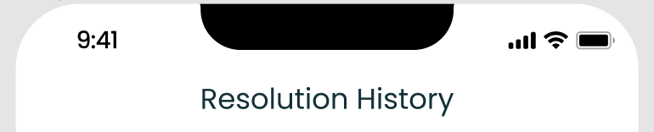
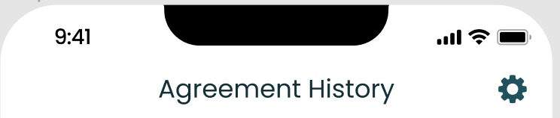
ISSUE: RESOLUTION HISTORY
The title says “Resolution History” but every other page refers to these as “agreements”. Inconsistent word usage. (H4)
Before
FIX:
Rename the title of the page to “Agreement History”.
After

Slide 25
ISSUE: MANAGING AGREEMENTS
There is no way to edit or delete an agreement that has made in the past and may no longer apply to the family anymore. (H7)

Slide 26
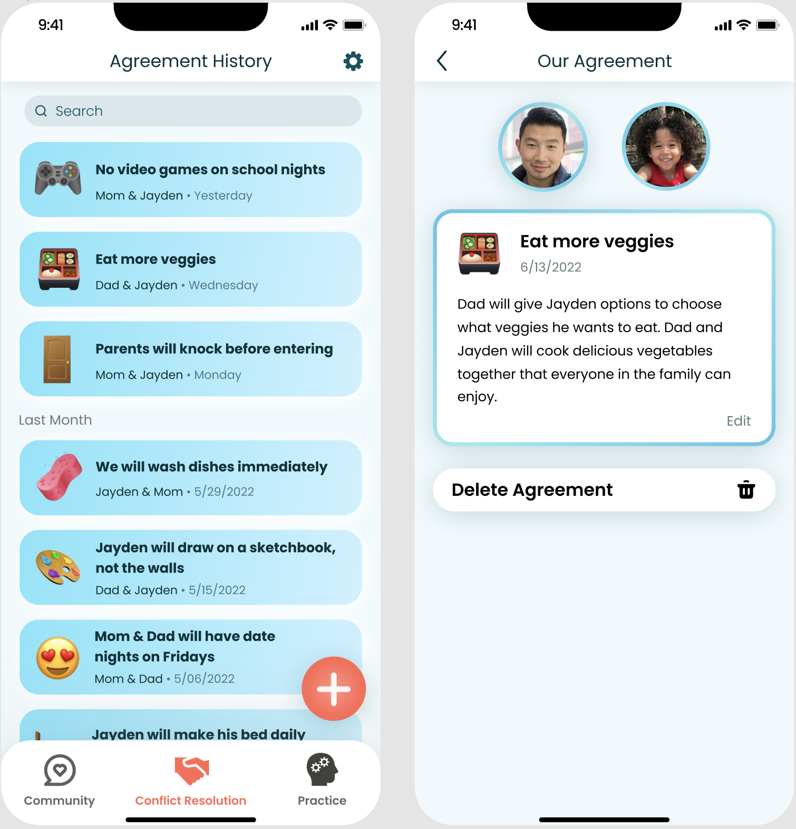
FIXES:
From the “Agreement History” page, users can
view a specific agreement by clicking on it.
Here, they can read the full description, edit, or delete the agreement.

Slide 27
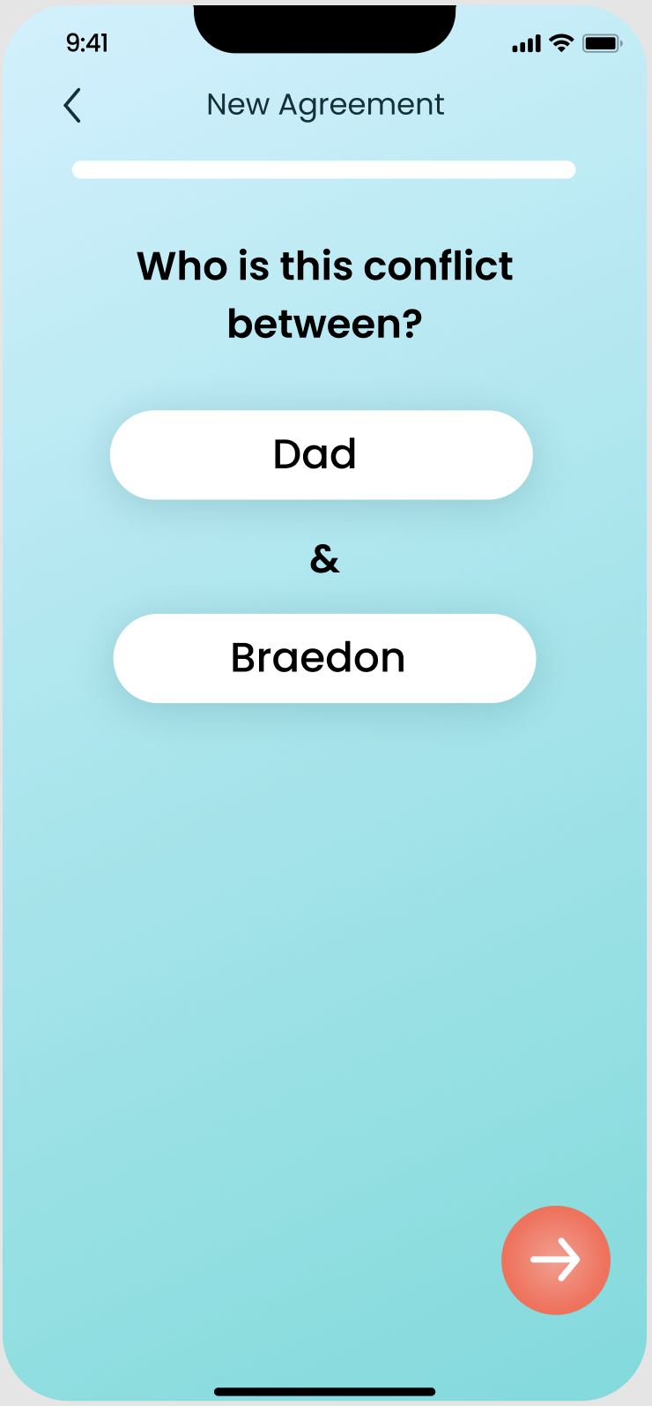
ISSUE: NEW AGREEMENT
Unclear how users input or select who the conflict is between. (H6)

Slide 28
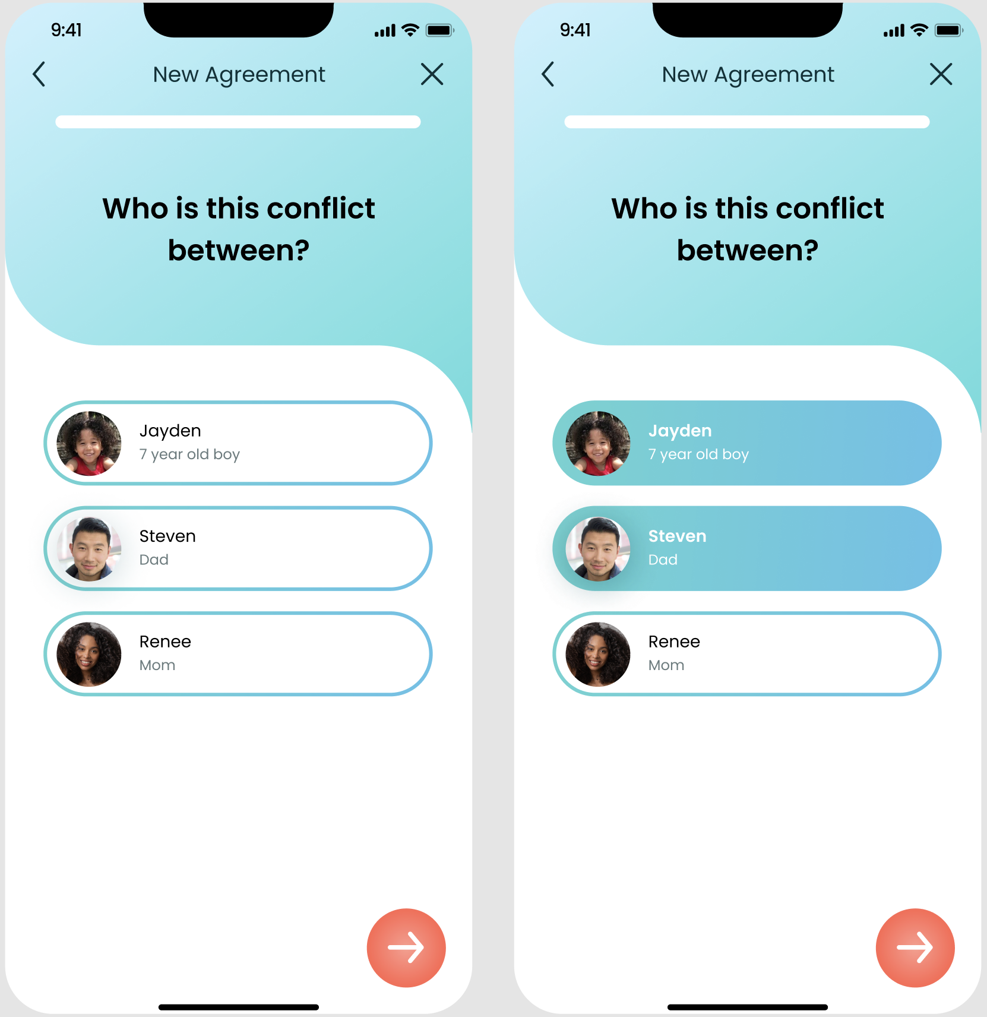
FIXES:
Family members created in the user’s profile will appear here.
Users can select which members are involved in the conflict.

Slide 29
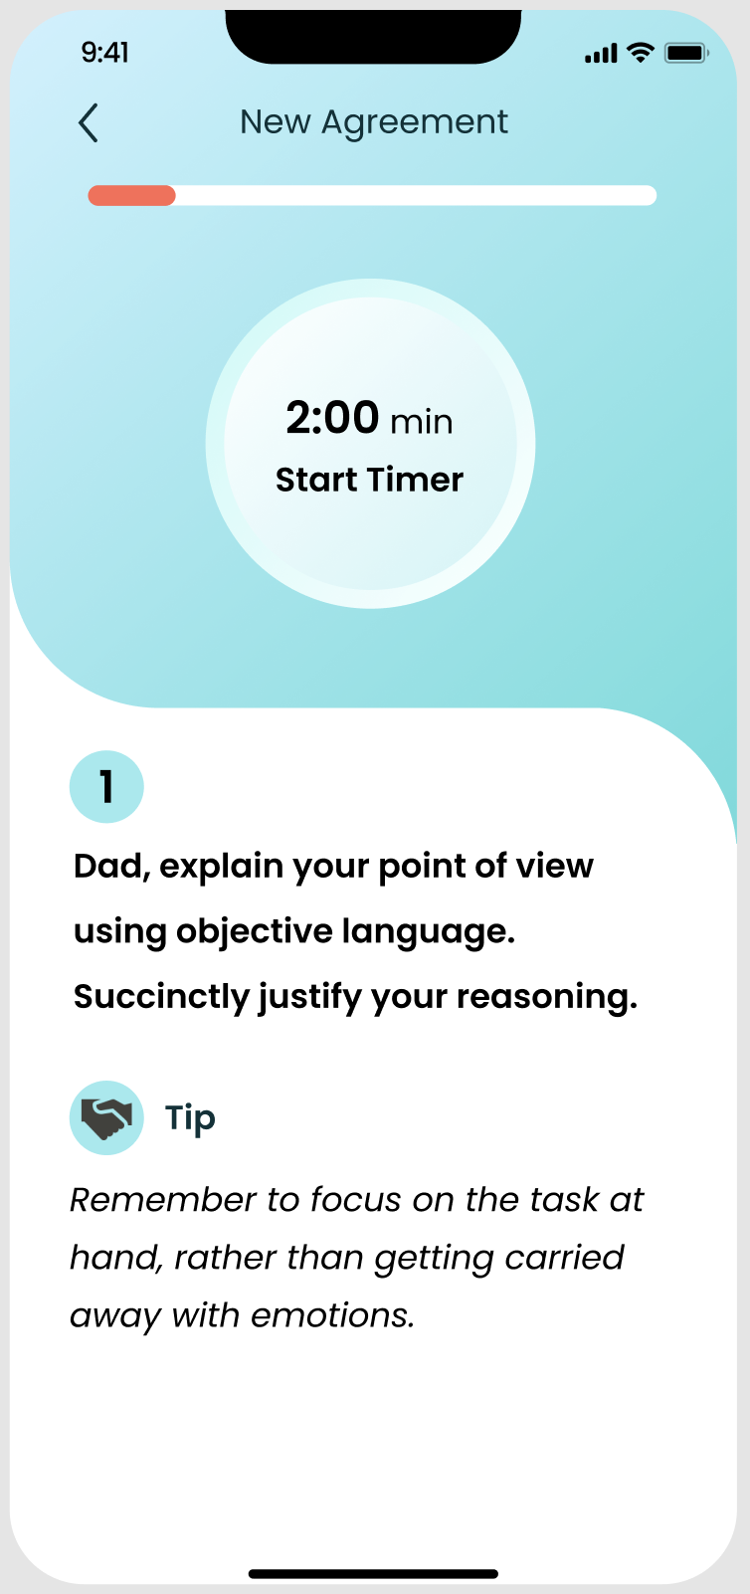
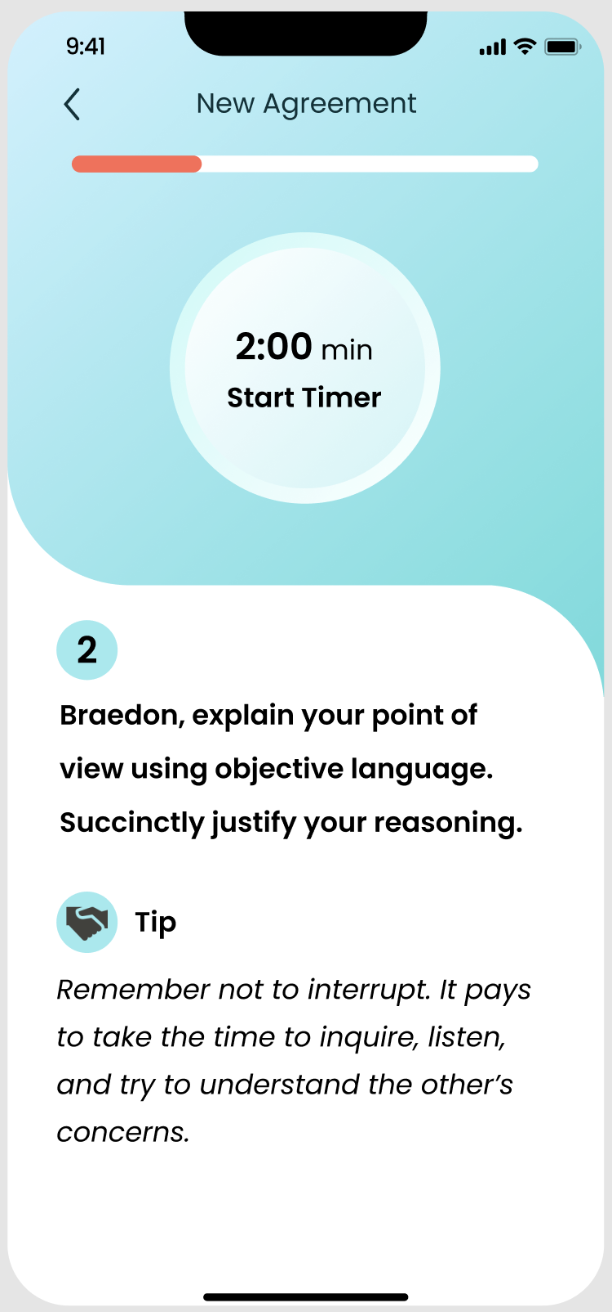
ISSUES: NEW AGREEMENT
The language used in the instructions is too complex for kids to understand. (H2)
Unclear who the tips are directed toward. (H2)

Slide 30
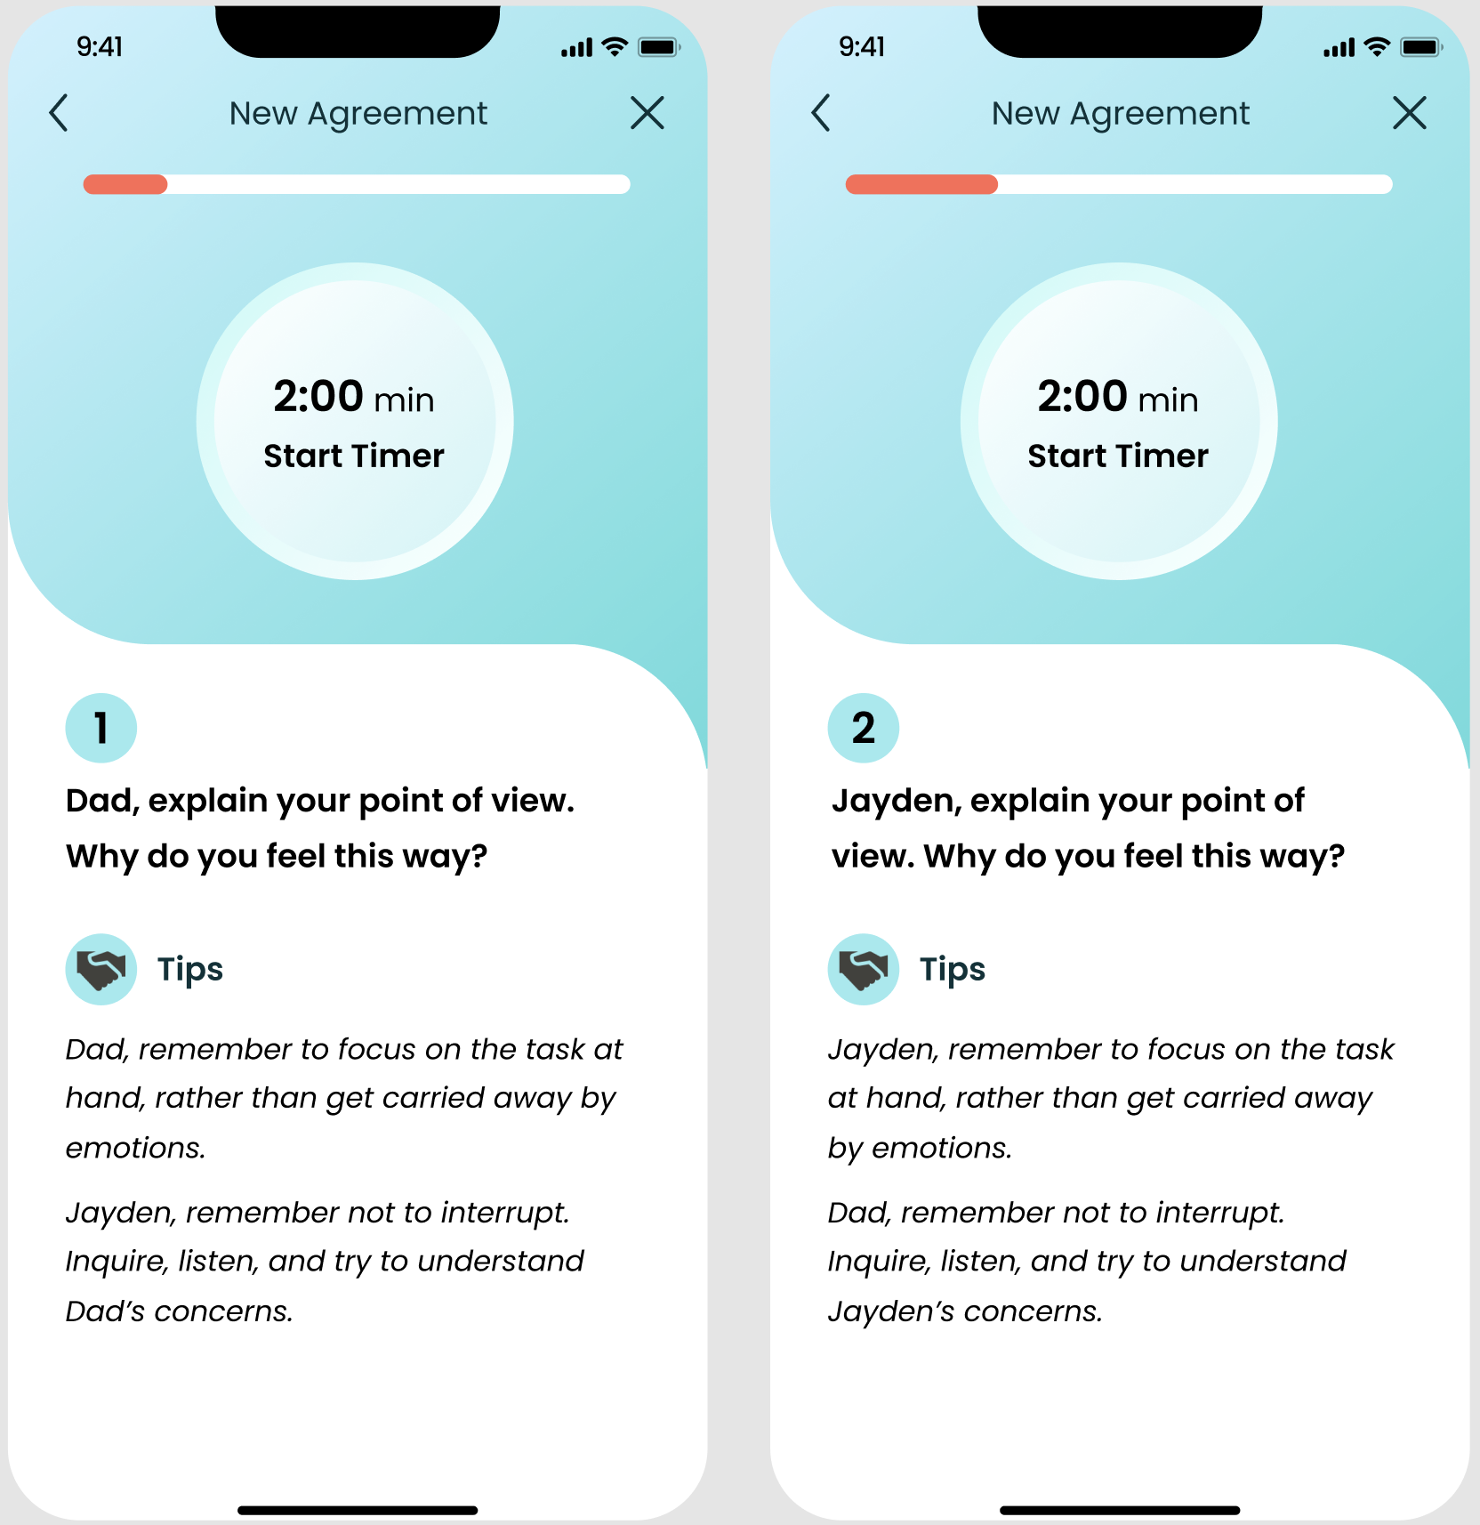
FIXES:
Simplify the language
used in the instructions.
Specify who the tips are directed toward.

Slide 31
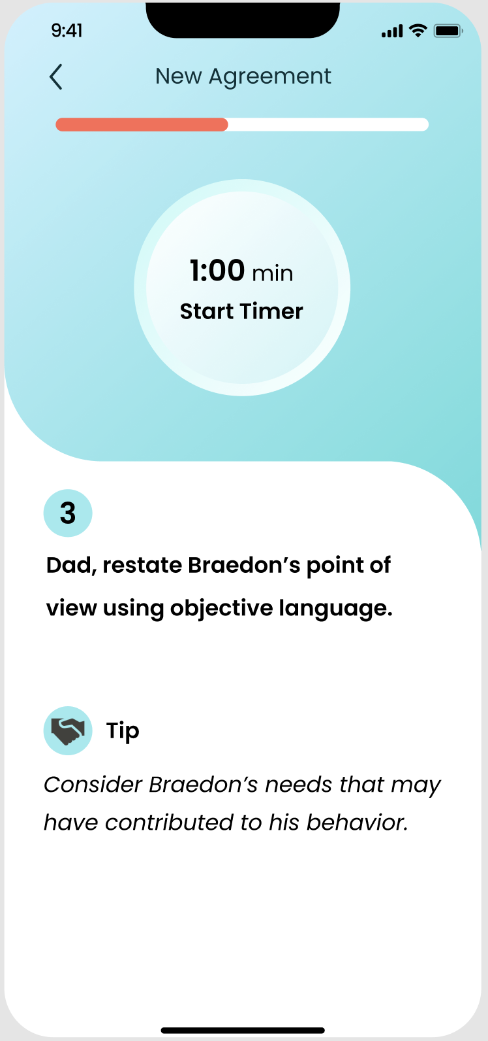
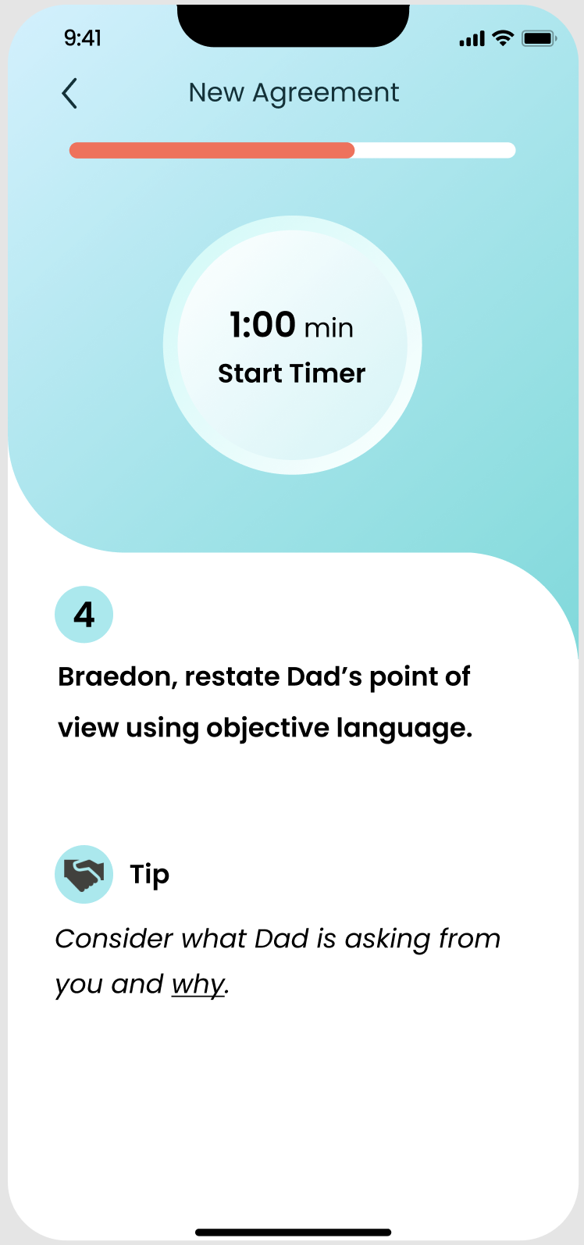
ISSUE: NEW AGREEMENT
When users restate the conflict, the tips assume that the conflict is due to Braedon’s behavior rather than Dad’s. Situations differ and it may be the other way around. (H2)

Slide 32
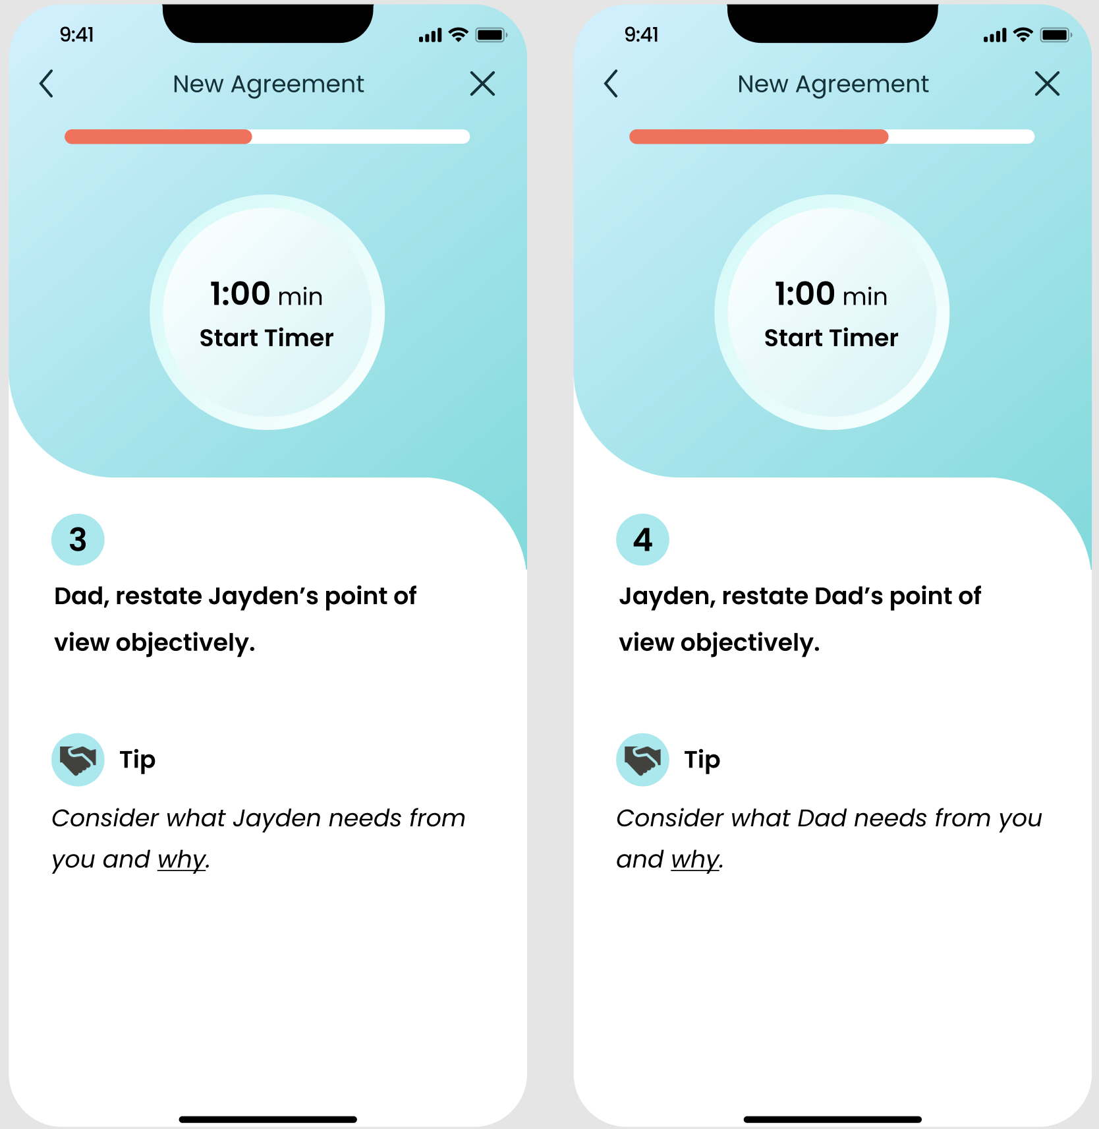
FIXES:
Make the tips the same for both parties.

Slide 33
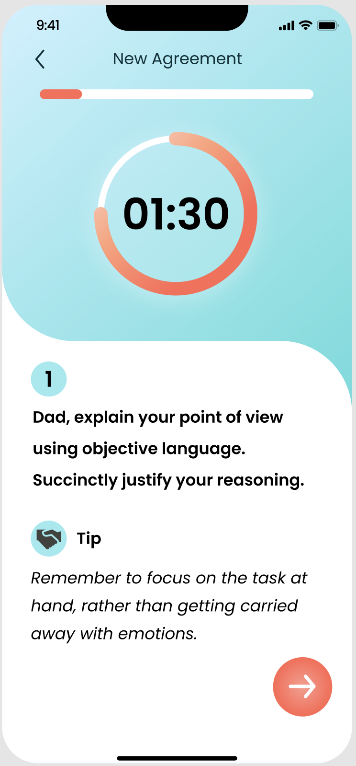
ISSUE: NEW AGREEMENT
The set timer may not be enough time for the user to complete the instructions. (H7)

Slide 34
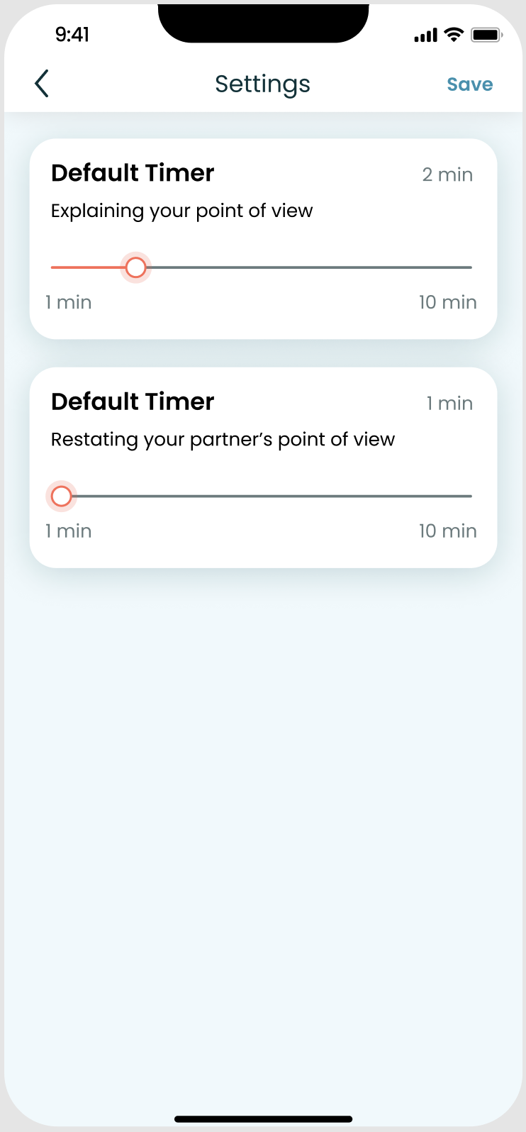
FIXES:
Add a settings icon to the “Agreement History” page that allows users to adjust the default timers for the two timed stages.

Slide 35
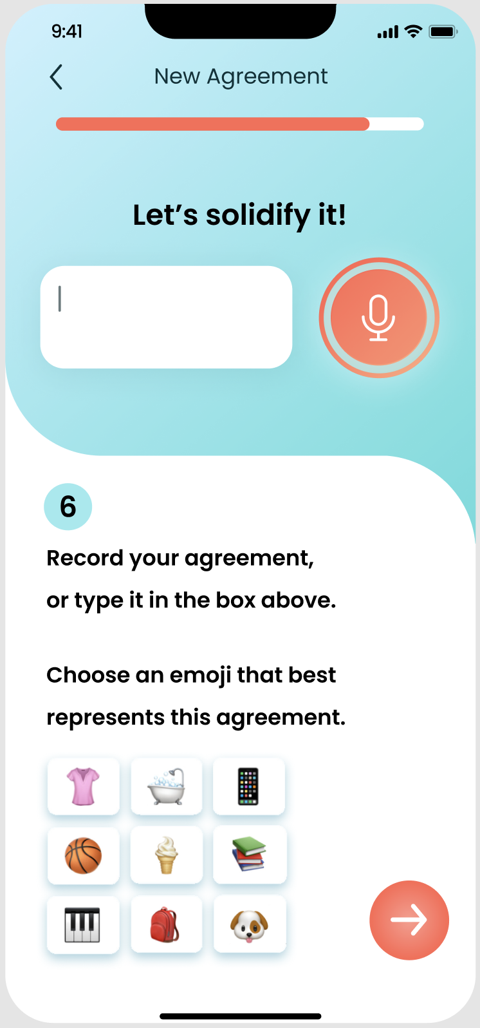
ISSUES: NEW AGREEMENT
Users are asked to record or type their agreement, but it seems that the user can do both and suffer no consequences. (H5)
There is an option to voice record, but users are unsure what a voice-recorded agreement would look like on the saved agreement page. (H4)

Slide 36
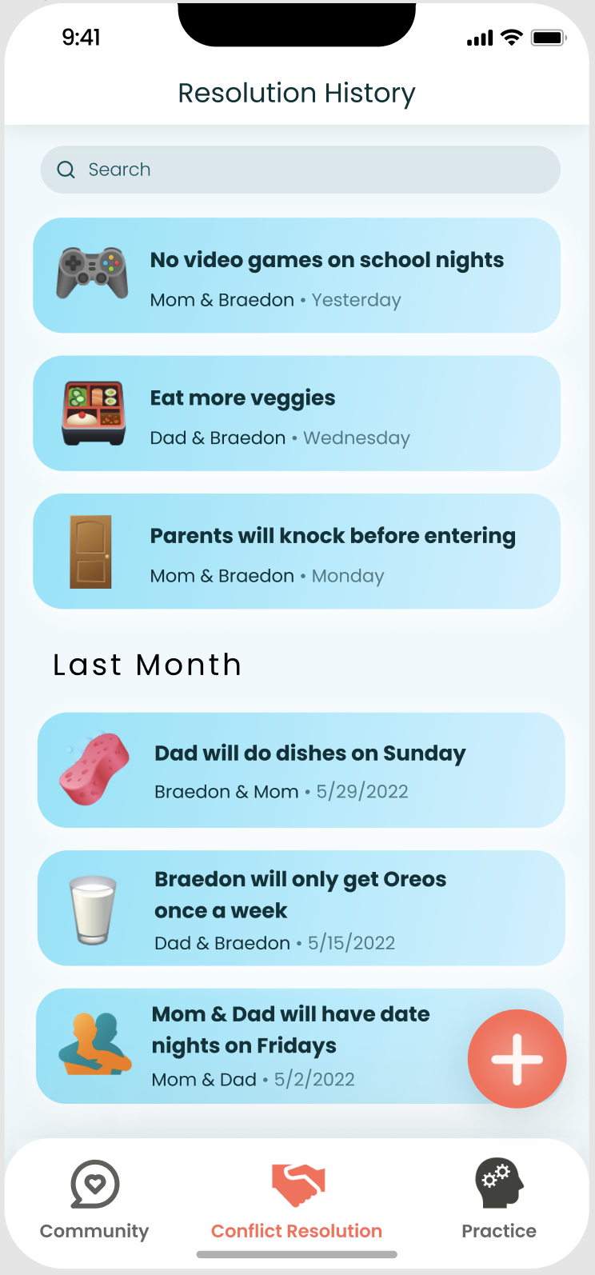
ISSUES: NEW AGREEMENT
No indication of a character limit when users input their agreement, but the “Resolution History” boxes have a fixed size. (H4)
The instructions and emojis are off-center. (H4)
The emoji options are limited and do not include all of the emojis used in the “Resolution History” page. (H4)

Slide 37
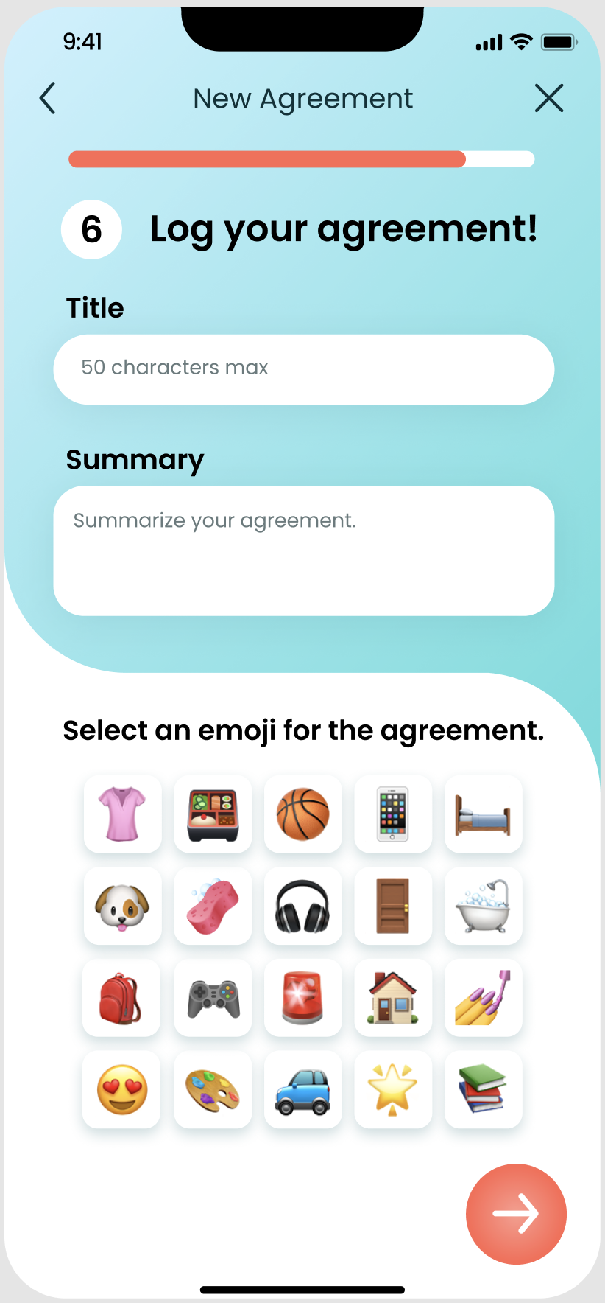
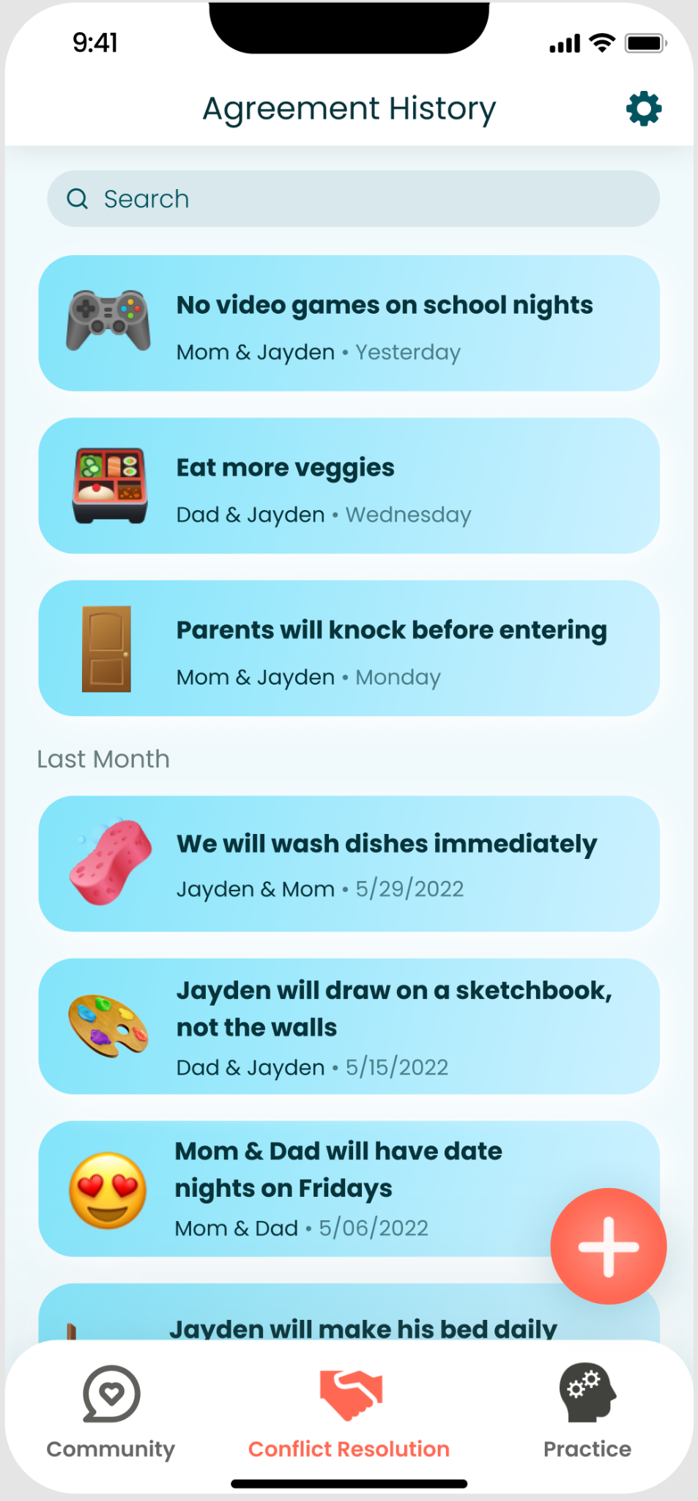
FIXES:
Remove the voice recording option entirely.
Move the instructions to the top so users can read and perform actions in sequential order.
Add a max character limit.
Center all UI elements.
Wider array of emojis to choose from, including the ones that are featured on the “Agreement History” page.

Slide 38
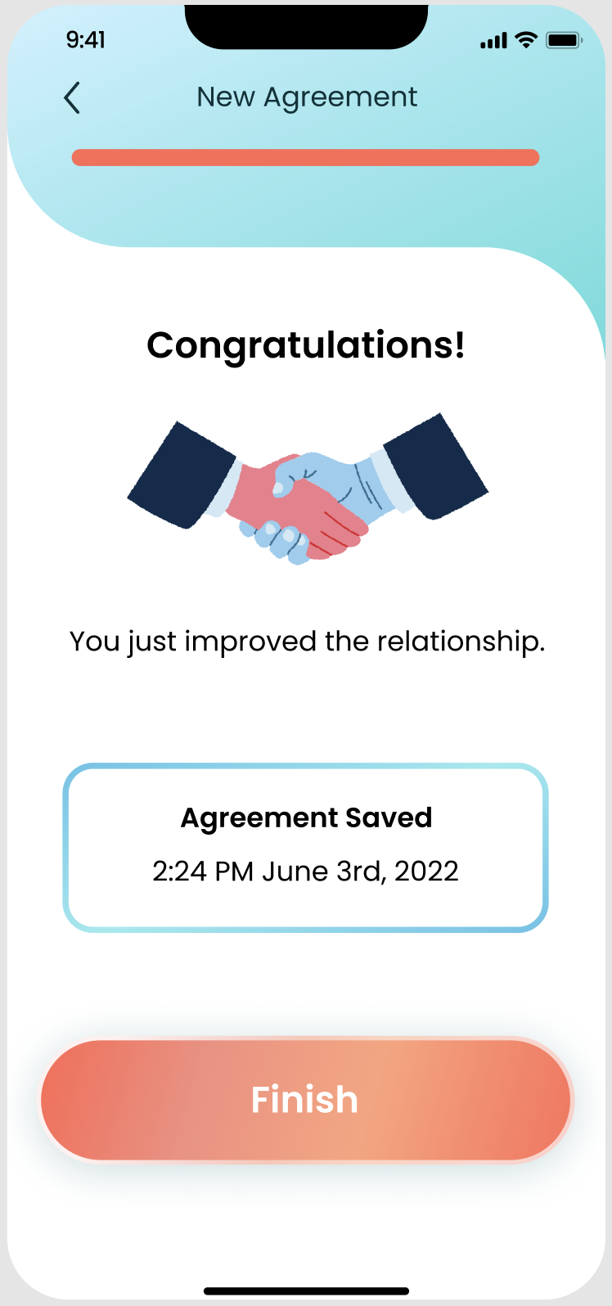
Process completion:
ISSUE: NEW AGREEMENT
As users go through the Conflict Resolution process, they can go backwards, but they cannot exit out of the entire process. (H3)
Once the agreement is saved, users are still able to go backwards in the process. This may leave users wondering if they can alter an already saved event. (H4)
During the process:
Notes:
UPDATE THIS PICTURE

Slide 39
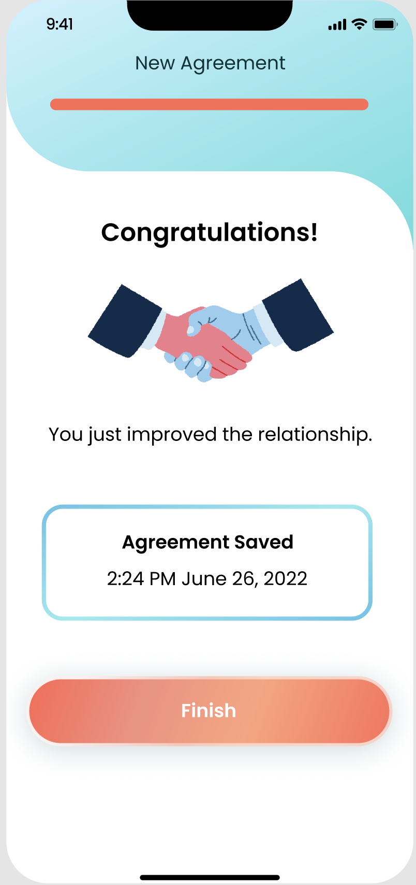
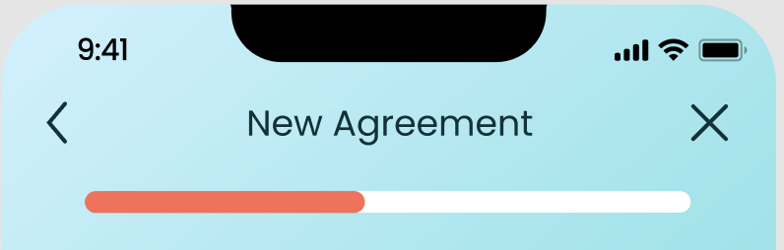
FIXES:
Once the agreement is saved, users cannot go backward.
Allow users to exit at any time during the process
Notes:
UPDATE THIS PICTURE

Slide 40
Additional
Needfinding
Hi-Fi Prototype
Status

Slide 41





Tools Used
React Native
Application Framework
Expo
Software Development Kit
VSCode
IDE
Redux
State Management
Figma
Design Components

Slide 42
Implemented Features
Community Tab (Simple Task)
View/Add/Delete posts and replies
Heart posts and replies
Search posts by content/topics
Filter posts by child’s age/gender
Practice Tab (Moderate Task)
View question of the day and practices
Conflict Resolution Tab (Complex Task)
View agreements

Slide 43
Unimplemented Features & Plan
Plan
View: finalize design for Conflict Resolution and Practice according to Figma
Save/Edit: Hook UI with state management to support data mutation and persistence
Implement Profile UI and evaluate remaining time for whether to support data mutation (not core task)
Practice Tab (Moderate Task)
View/Save practice progress
Conflict Resolution Tab (Complex Task)
Save/Edit agreements
Misc
View/Edit profile

Slide 44
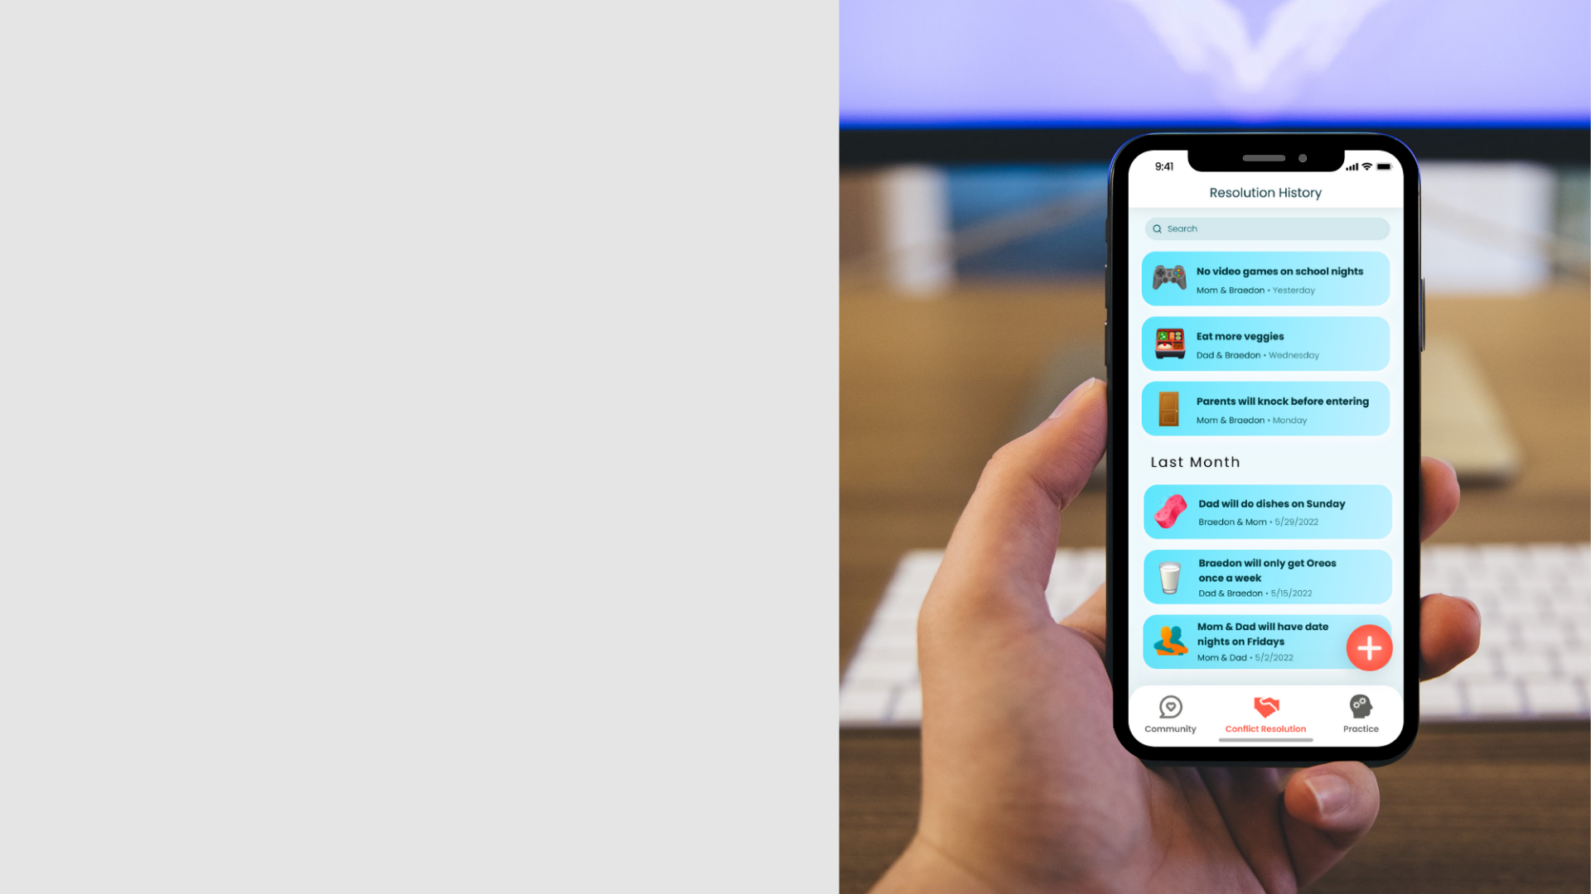
Wizard of Oz
Hard-coded Items
Recommendations and personalizations are implemented by Wizard of Oz
Recommended Topics and Trending Now in the Search screen
Selectable topics in the New Post screen
User profiles: pre-existing user profiles (names & photos), including the current user, fellow parents and experts
Community posts: pre-existing posts and replies as well as the “heart” count
Practice questions: Question of the Day and two sets of practices
Agreement entries: pre-existing agreements between hard-coded family members

Slide 45
Additional
Needfinding
Hi-Fi Prototype
Demo

Slide 46
Summary
Heuristic Evaluation
Design Revision
19 severity 3-4 violations & 13 changes
49 severity 1-2 violations & 23 changes
Consistency
Efficiency
Wording
1
2
3
Prototype Progress
Community: 100%
Conflict Resolution: 80% (with UI & transitions / without data mutation)
Practice: 60% (with UI & transitions / without data mutation)

Slide 47
Additional
Needfinding
Thank You!

